Slide 1
E-Consult Workgroup January Webinar January 20, 2021, 12-1 PT https://us02web.zoom.us/j/9689264532

Slide 2
Agenda
Welcome
Funder and Sponsor Introductions
Featured Presentation Ontario eConsult Program: Provider Perspectives and Vascular Surgery eConsults
Dr. Clare Liddy, Family Doctor & Co-Executive Director, Ontario eConsult Program
Alexander Hajjar, MD Candidate 2022, Queens University
Claire Sethuram, MD Candidate 2024, University of Toronto
Clinical Advisor Perspectives
Patient and Provider Stories – econsultworkgroup.com
Next Steps
Notes:
Libby

Slide 3
Welcome
https://econsultworkgroup.com/

Slide 4
Funder and Sponsor Introductions
We thank California Health Care Foundation for its support of our work and appreciate our 2020 sponsors’ contributions.
Silver
2021 E-Consult Workgroup Sponsors to-date
Bronze
To learn about 2021 sponsorship, visit econsultworkgroup.com. To sponsor, contact libby.sagara@bluepathhealth.com.
SAVE THE DATE! E-Consult Workgroup Annual Meeting - November 9-10, 2021

Slide 5
Featured Presentation

Slide 6
Ontario eConsult Program: Provider Perspectives and Vascular Surgery eConsults
E-Consult Workgroup Webinar
January 20th, 2021, 12:00 – 1:00 pm PT
Dr. Clare Liddy
Family Doctor & Co-Executive Director, Ontario eConsult Program
Alexander Hajjar
MD Candidate 2022, Queens University
Claire Sethuram
MD Candidate 2024, University of Toronto

Slide 7
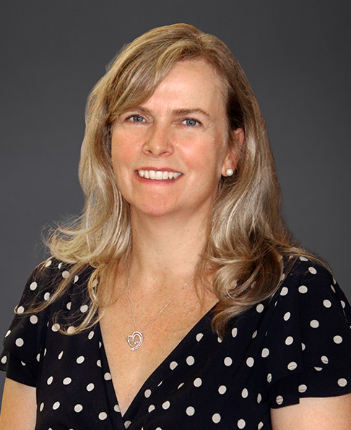
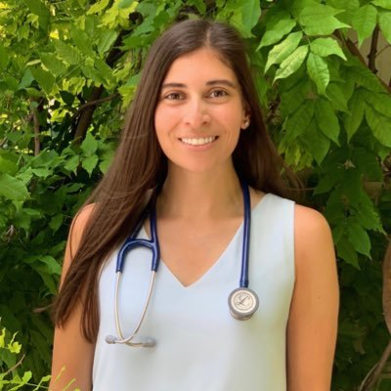
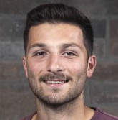
Introduction to Presenters
Dr. Clare Liddy
Family Doctor
Co-Executive Director Ontario eConsult Program
Alexander Hajjar
MD Candidate 2022
Queens University
Claire Sethuram
MD Candidate 2024
University of Toronto

Slide 8
The BASE eConsult Team
A collaboration between:
Champlain Local Health Integration Network
The Ottawa Hospital
Bruyère Research Institute
Winchester District Memorial Hospital
Program Funding
Champlain Local Health Integration Network
Ontario Ministry of Health
Current Research Funding
Canadian Institutes of Health Research
Bruyère Research Institute
Canadian Foundation for Healthcare Improvement
Clare Liddy Primary Care Lead | Erin Keely Specialist Lead | Amir Afkham Engagement & Implementation Lead
cliddy@bruyere.org | ekeely@toh.ca | Amir.Afkham@lhins.on.ca
613-562-6262, Ext. 2928 | 613-738-8400, Ext. 81941 | 613-747-3235
Notes:
8

Slide 10
eConsultBASE™
From a cup of coffee to innovation
Held initial meeting with PCPs and developed e-form
Launched proof of concept with 5 specialties
Solicited ongoing feedback and evaluation from users
Collaborated with national organizations (CFPC, RCPSC)
Received CIHR grant supporting knowledge to action
Partnered with CFHI for Connected Medicine Collaborative
MOHLTC established eConsult COE to manage provincial rollout
Funded by MOH as provincial eServices Program
2009
2010
2011
2012
2013
2014
2015
2016
2017
2018
2019
2020
Conducted Privacy Impact & Threat Risk Assessments, contacted CMPA
Launched pilot of eConsult
Received infrastructure support from Champlain LHIN
Collaborated with provincial organizations (MOHLTC, OTN, OMD)
Launched pilot in Mississauga Halton LHIN
Funded by MOH as provincial program
Now in expansion mode across Canada

Slide 11
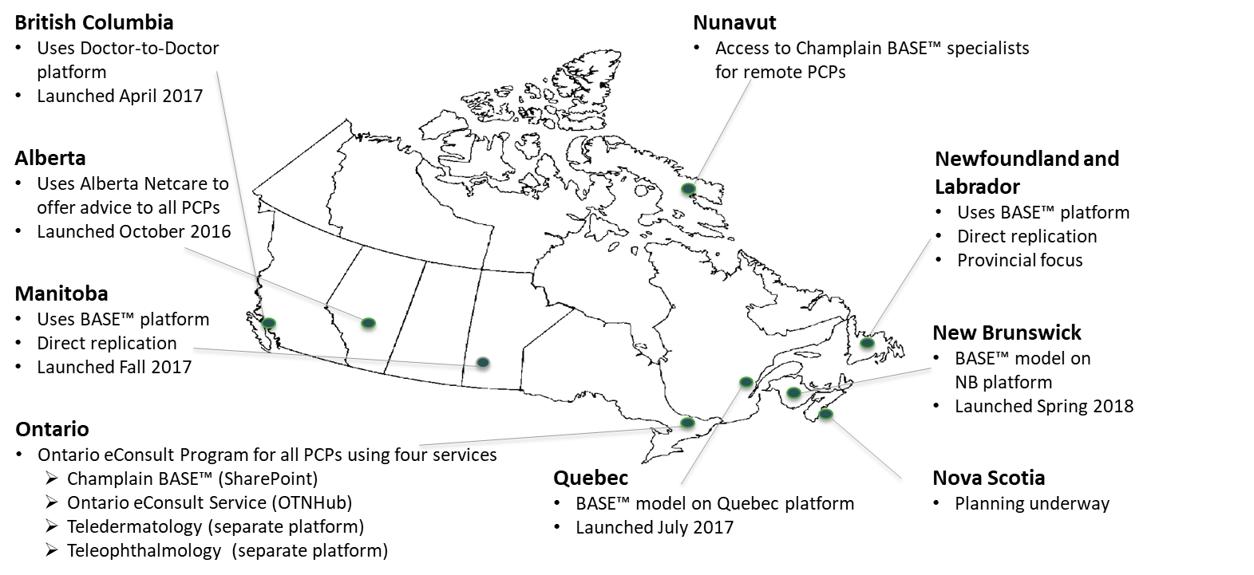
National Spread of eConsult Across Canada
eConsult services now operate in 9 provinces/territories across Canada

Slide 12
Provincial BASETM Managed Specialty Groups (n=101)
*as of Oct 23rd, 2020
Addiction Medicine
General
Opioid
Allergy & Clinical Immunology
General & Pediatrics
Anesthesiology
Cardiology
General & Pediatrics
Cardiac Surgery
Electrophysiology
Inherited Heart Rhythm Disorders
Interventional
Pediatrics Electrophysiology
Pediatrics Inherited Heart Rhythm Disorders
Cannabis Medicine
Concussion
Dentistry
Pediatric
Dermatology
General & Pediatrics
Diabetes
Endocrinology
General & Pediatrics
Diabetes
Environmental Health
Gastroenterology
General & Pediatrics
Genetics
Medical Genetics
Pediatric Medical Genetics
Geriatrics
Care of the Elderly
Frailty Management
GeriMedRisk
Medication
Psychiatry
Gynecology
General & Pediatrics
Gynecologic Oncology
Gynecologic Reproductive Endocrinology & Infertility
Urogynecology
Hematology
General & Pediatrics
Hepatology
General & Pediatrics
HIV
General
Psychiatry
Infectious Diseases
General & Pediatrics
COVID-19
Internal Medicine
Nephrology
General & Pediatrics
Neurology
Epilepsy
Headaches
General & Pediatrics
Neuroradiology
Neurosurgery
Sleep Medicine
Stroke
Obstetrics
Orthopaedics
General & Pediatrics
Spinal Surgery
Otolaryngology
ENT
Head & Neck Surgery
Pain Medicine
Palliative Care
Pediatrics
General
Allergy & Clinical Immunology
Cardiology
Dentistry
Dermatology
Electrophysiology
Endocrinology
Developmental
Gastroenterology
Hematology
Hepatology
Infectious Diseases
Inherited Heart Rhythm Disorders
Neonatal/Perinatal
Medical Genetics
Nephrology
Neurology
Oncology
Orthopaedic Surgery
Psychiatry
Urology
Physical Medicine & Rehabilitation
Psychiatry
General (English & French)
ADD/ADHD
Anxiety
Depression, Bi-Polar Disorder
Developmental/Behavioural
Medically Complex
Mood Disorders
Pediatrics
Perinatal
Sleep Medicine
Transitional Age (16-25)
Public Health
Respirology
General
Sleep Medicine
Rheumatology
General
Inflammatory Arthritis
Osteoporosis
Sleep Medicine
Neurology
Psychiatric
Respirology
Surgery
General
Head and Neck
Neurosurgery
Orthopaedic Surgery
Pediatric Orthopedic Surgery
Plastic Surgery
Spinal
Thoracic
Vascular
Thrombosis
Transgender
Urology
General & Pediatrics
Male Fertility/Sexual Medicine
Oncology
Urogynecology

Slide 13
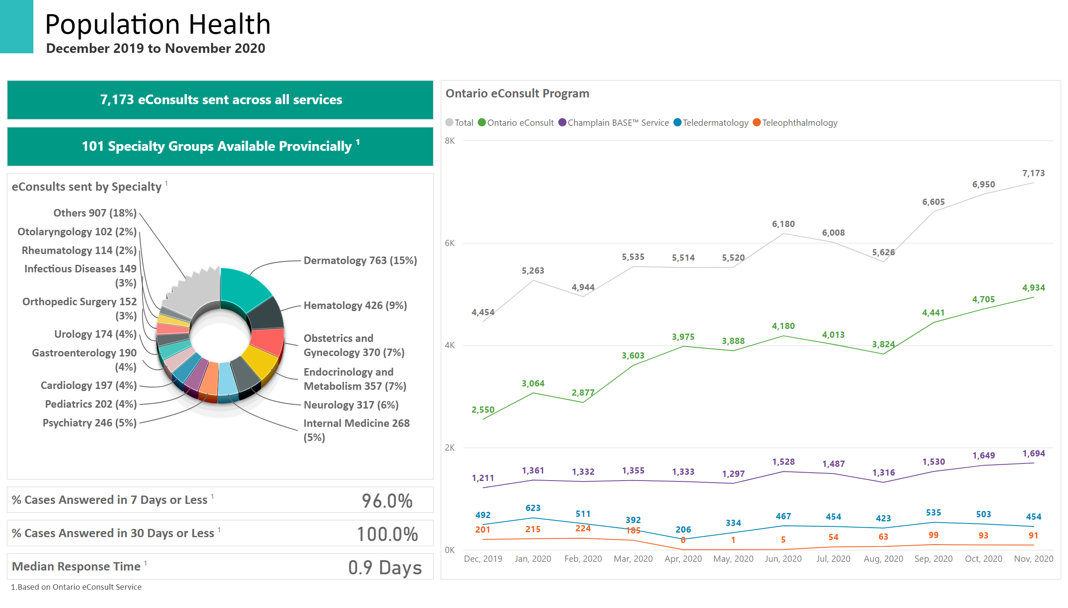
eConsult

Slide 14
Research Program
Special Projects
Artificial Intelligence and Data Mining
Chronic Pain
Correctional Settings
COVID-19
Dementia
Frailty
Long-Term Care
Rural and Remote Populations
Continuous Themes
Continuing Medical Education
Quadruple Aim Framework
Patient Engagement
Person-Centered Care
Program Evaluation
Taxonomy Studies (case content analysis)
Spread and Scale

Slide 15
Current Status of eConsult in Long-Term Care
990 LTC eConsults identified across Ontario between January 1, 2017 and September 30, 2020¹.
675 eConsults submitted on the Ontario eConsult Service
315 eConsults closed on the Champlain BASETM Service
Approx. population rate of 5.21 eConsults per 1000 LTC residents²
1. This data is based on cases initiated by primary care providers with an LTC home as their primary organization.
2. Based on 12 month eConsult volume on Champlain BASETM and Ontario Service (Oct 2019 to Sep 2020) and LTC population of 65,841

Slide 16
eConsult in Correctional Settings – Ongoing Research
Scoping Review
To provide an overview of the use of and evidence for eConsult in correctional facilities worldwide
To inform our discussions regarding the implementation of eConsult across Canadian correctional facilities
Qualitative Study – Interviews with users and stakeholders
To understand the learnings from the initial development of the Ontario eConsult Program in Canadian correctional facilities
To describe recommendations for future use

Slide 17
Primary care providers’ perspectives on the Ontario eConsult Program
Claire Sethuram
Study Authors: Clare Liddy, Claire Sethuram, Ariana Mihan, Isabella Moroz, and Erin Keely

Slide 18
Purpose of the Study
To examine the perspectives and experiences of primary care providers (PCPs) with the Ontario eConsult Program

Slide 19
Methodology
Conducted a 24-question web survey of PCPs registered for the Ontario eConsult Program
Survey remained open for 8 weeks (June 28th to August 26th, 2019)
Survey explored PCPs’ opinions in three key areas:
Experience with the service
Remuneration
Recommendations for enhancement

Slide 20
Results
1,256 PCPs completed the survey (16% response rate)
78% had submitted an eConsult and 14% had not (8% did not specify)
Top three reasons for using eConsult:
Reduced wait times
Ability to access specialist advice for patients who are unable to visit a specialist
Reduced need to reach specialists by phone

Slide 21
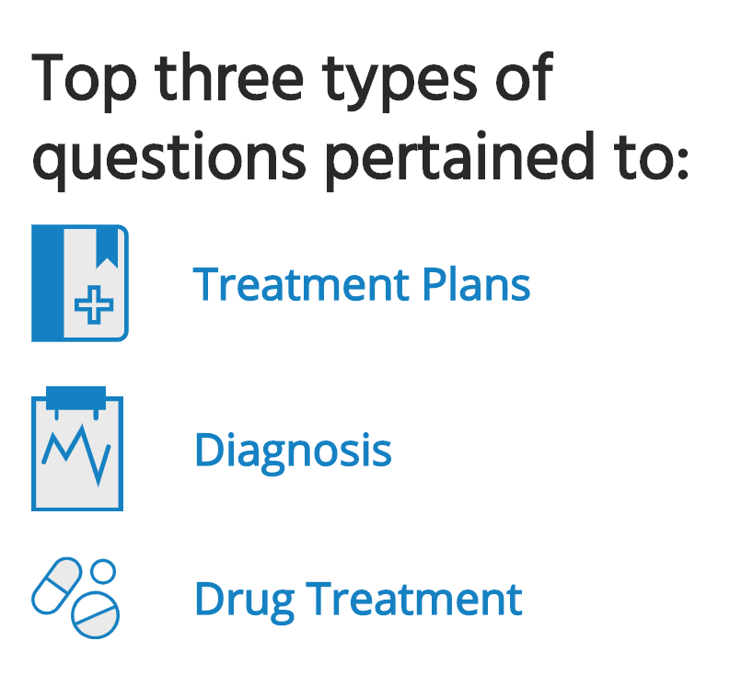
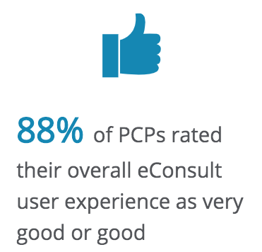
Experience with the Service

Slide 22
Experience with the Service
Figure 1. PCP perspectives on their experience with eConsult

Slide 23
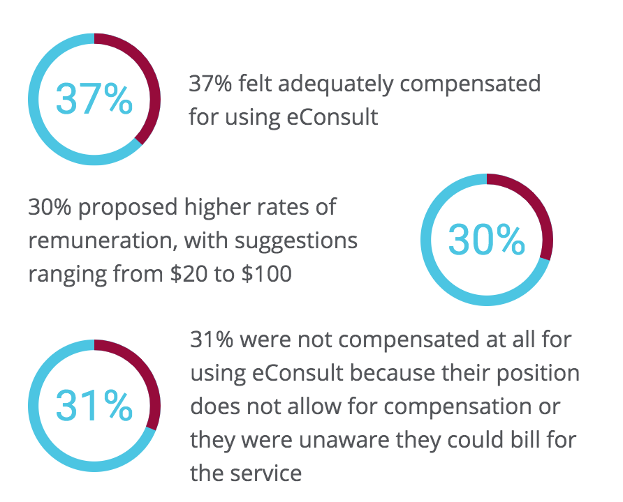
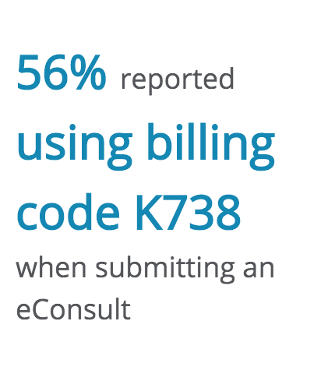
Remuneration

Slide 24
Recommendations for Enhancement
Figure 2. PCP recommendations for service enhancement

Slide 25
Limitations of Study
Response rate of 16%
Limited to a single province
Susceptible to recall bias

Slide 26
Conclusion
Overall, PCPs reported having positive experiences with the Ontario eConsult Program
The majority of PCPs did not experience increased workloads and had no trouble incorporating eConsult into their workflow
PCPs had mixed opinions on remuneration
Desired improvements include EMR integration
This paper was published in the journal Telemedicine and e-Health: https://doi.org/10.1089/tmj.2020.0338

Slide 27
The Vascular eConsult An efficient, useful, and economical tool for primary care physicians to interact with a vascular specialist, for proper care of the vascular patient
Alexander Hajjar
Study Authors: George Hajjar, Alexander Hajjar, Clare Liddy, Amir Afkham, and Erin Keely

Slide 28
Purpose of the Study
To describe the use of eConsult in vascular surgery through the analysis of question type and user feedback

Slide 29
Methodology
All (n=553) eConsults submitted to the University of Ottawa department of vascular surgery were accessed and analyzed for basic utilization data (January 2014 – June 2020)
For 363 eConsults, case-based data was available at the time of this review allowing for subanalysis on question type and content classification
Utilization Data Analysis:
Patient demographics
Time to first specialist response
Specialist time spent on eConsult
PCP exit survey responses
Number of cases included in subanalysis (n=360)
Case Based Analysis:
Question Type
Clinical Topic
(n=363) eConsults opened for a subanalysis of case content for question type and clinical topic
(n=553) eConsults submitted to uOttawa Vascular
3 incomplete eConsults excluded
(n=190) eConsults did not yet have Case Based Data available for review
Notes:
Utilization data included data on patient age and sex, time tospecialist first response, specialist time spent on case, and PCP exit survey responses. All cases from january 2014-june 22 2020
Case Based/Case content data contained the econsult along with appended files for the eConsult, thee were further analyzed
Done at the end of the year (6 months after year) we were doing analysis in march

Slide 30
Methodology – Development of Taxonomy
Question type was developed based on a validated taxonomy (TCPQ)
Diagnosis, Management, Treatment, Epidemiology, Unclassified
MGMT: “What should we do with this aneurysm?” “What follow up do you recommend?”
TX: “Is there a case for endarterectomy here?” “What strength of compression stockings?”
Clinical topics
Aortoilliac aneurysms, CVD, PVD, Raynaud’s, Ulcers, Edema, Pop Aneurysms, Visceral Aneurysms, Venous Disorders, TOS, Mesenteric Ischemia, Other, Wrong Specialty
Agreement was determined prior to data extraction on a small sample of 20 cases to crosscheck and ensure consistency
Notes:
Disagreements were resolved and following this initial pilot, AH categorized the remaining 340 eConsults independently

Slide 31
Results
553 eConsults submitted to vascular surgery by 296 PCPs from January 2014 – June 2020
MD: 508 (92%)
NP: 45 (8%)
Time to first response:
Median: 6.28 hours
Mean: 20.89 hours (4 minutes-14 days)
Self reported specialist time spent per case:
Median: 10 mins
73.1% of cases ≲ 10 mins
Mean: 11.26 mins (5-35 mins)
Notes:
Age: Median: 68
Mean: 65 (6 mos–100 yrs)
Volume not decreasing, half year, suspect 130 cases by years end. Likely plateauing at this level
Since inception, concept has been widely accepted where it has likely plateaued in the area of 150
Service did not peak, most eConsults that year for vascular surgery in Champlain Region

Slide 32
What is the value of eConsult to PCPs?
95% (n=506) of PCPs found the service to be helpful-extremely helpful
“I was able to confirm my original course of action”: 49% (n=553)
“I received good advice for a new/additional course of action”: 47% (n=553)
Notes:
237 openings in clinic for patients
What is…

Slide 33
What is the Impact of eConsult on Face-to-Face Referral?
345 (n=553) referrals were initially contemplated by PCP
Following eConsult, 69% (237) of contemplated referrals were no longer needed
185 referrals were not originally contemplated
Following eConsult, 11% (20) were needed
eConsult modified PCP referral behaviour in 49% of cases
Referral not contemplated and now needed
Referral not contemplated and still not needed
Notes:
This cost is strictly avoided referrals, excluding travel costs to the patient, days off work, environmental and transport, cost
Savings just from avoided face to face physician fee
Net Savings to the system ($11 446.2) in professional fees alone
217 net in person consults avoided @ $19 595.1 versus $8 148.9 eConsult compensation

Slide 34
Case-Based Data Analysis
Proportion of eConsult Questions by Question Type
Clinical Content Area and Specific Question Type of Vascular Surgery eConsults
Vascular Surgery Clinical Topic | Percent of Total eConsults (%) | #1 Common Question Type (n=447) | #2 Common Question Type (n=447)
Peripheral Vascular Disease | 23.9 | MGMT: of condition/finding | MGMT: Referral
Aortoilliac Aneurysms | 17.5 | MGMT: of condition/finding | DX: Timing/Monitoring finding
Cerebrovascular Disease | 13.3 | MGMT: of condition/finding | TX: Recommendation for treatment
Other | 12.8 | - | -
Varicose Veins | 6.9 | - | -
Visceral Aneurysms | 6.7 | - | -
Wrong Specialty | 5 | - | -
Edema | 4.4 | - | -
Raynaud’s | 3.3 | - | -
Thoracic Outlet | 2.2 | - | -
Mesenteric Ischemia | 1.7 | - | -
Popliteal Aneurysms | 1.1 | - | -
Ulcers | 0.8 | - | -
Phlebitis | 0.3 | - | -
Notes:
MGMT: of condition/finding: How should I manage condition/finding/situation y?
ex: What should we do with this aneurysm? Please address the significance of this result, can you comment on next steps? What follow up do you recommend?
MGMT: referral: When should you refer?
ex: Do results of ABI merit referral? Should they be seen? What size qualifies for referral?
3. TRT: recommendations for treatment: How should I treat? What are the treatment options?
ex: Is there a case for endarterectomy here? Would the patient benefit from surgical bypass? What strength of compression stockings?

Slide 35
Conclusion
Overall
Rapid growth and acceptance
Valuable service, well received by PCPs
Avoids unnecessary referrals and saves $$
Guides patient management
Educational Benefit
Designing future CME and medical school curricula to enhance education in identified areas
Benefit to Patients
Shorter wait times
Directed care
Saves patient + caregiver time off work
Decreases travel expenses, impact on environment
Notes:
Service is very timely in a pandemic
(less tests, less travel)
*public schools close march 12, sports suspend seasons, March 16, its time to come home, border closes, practice physical distancing, self isolate, make virtual arrangements when possible, emergency decleration march 17
COVID-19:
January 1, 2020 – March 14, 2020: 30 eConsults
March 15, 2020 – June 26, 2020: 35 eConsults

Slide 36
Questions?

Slide 37
More Information and Contacts
For more information about the eConsult, please visit the Ontario eConsult Program website at www.eConsultOntario.ca
For questions about eConsult, please contact Dr. Clare Liddy at Cliddy@uottawa.ca

Slide 38
Thank You!

Slide 39
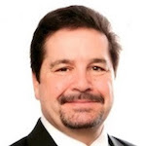
Clinical Advisor Perspectives on Primary Care Provider Engagement
Lisa Arfons, MD
Acting Clinical Deputy
Office of Veterans Access to Care, VHA
Greg Buchert, MD, MPH
CEO, GSB Health Management Solutions
Former CEO and President, Blue Shield of California's Promise Health Plan
and Centene's California Health and Wellness Plan
Paul Giboney, MD
Associate Chief Medical Officer
LA County Department of Health Services
Delphine Tuot, MDCM, MAS
Zuckerberg SF General, Associate Professor in Residence
Center for Vulnerable Populations, ZSFG
Notes:
Libby

Slide 40
Call for Submissions: Patient and Provider Stories
econsultworkgroup.com/playbook

Slide 41
Featuring Payer and Provider Collaboration
https://econsultworkgroup.com/fresno

Slide 42
Electronic Consultations (eConsults) for Safe and Equitable Coordination of Virtual Outpatient Specialty Care
The pandemic has presented a unique set of challenges for the specialty care delivery system, including increased volumes of consultations and referrals…as well as an increased need for virtual specialty care access for management of other conditions in particularly at-risk patients.[4] [6] Coordination and transition of care between primary and specialty care are of utmost importance at a time when in-person communication may be more fragmented and more patients need timely input from specialists without putting themselves at unnecessary risk of exposure to COVID-19 through in-person visits.
Recent Publication
eConsults have the potential to both facilitate and moderate transitions of care between primary care and specialists, especially as the COVID-19 pandemic continues to create both increased need for—as well as additional barriers to providing—high-quality, timely specialty care. By embracing such technologies that enhance timely and complete interprofessional communication, specialists and PCPs can share in the successes of making the health of both individuals and populations more efficient, safe, and equitable.
February 24 E-Consult Workgroup Featured Speakers, Michelle Lee MD, Harvard Medical School, and Vinod Nambudiri, MD, MBA, Brigham and Women’s Hospital
Michelle S. Lee, Vinod E. Nambudiri, Appl Clin Inform 2020; 11(05): 821-824 DOI: 10.1055/s-0040-171918 https://www.thieme-connect.com/products/ejournals/abstract/10.1055/s-0040-1719181

Slide 43
Next Steps
Announcements
Call for stories and collaborative programs
Next E-Consult Workgroup Meeting – February 24, 2021, 12 PT
Visit e-consultworkgroup.com for events, policy updates and recent publications

