Slide 1
© California Telehealth Policy Coalition and E-Consult Workgroup, 2024

Slide 2
Keynote Speaker
Barbara Rubino, MD
Associate Chief Medical Officer, Covered California
© California Telehealth Policy Coalition and E-Consult Workgroup, 2024

Slide 3
Policy Versus Reality: Addressing Gaps for Telehealth Sustainability
Barbara Rubino, MD
Associate Chief Medical Officer;
Manager, Health Informatics
Health Equity & Quality Transformation Division
Notes:
Good morning thank you so much for having me my name is Barbara Rubino and I'm the associate chief medical officer at Covered California I am also a primary care internal medicine physician.
I am honored to be here to talk to you today about the policy versus reality of making telehealth sustainable in California.

Slide 4
Introduction
Notes:
Today I will start by introducing myself and why I'm here to talk about this critical topic both as a PCP, and as a state and national advocate for equitable healthcare policy.
I’ll pose this to the room before we begin – why are you here, in your role, now? What can you do to be an advocate and contribute to state and national discussion proactively, meaningfully.

Slide 5
CARING FOR PATIENTS USING TELEHEALTH
Notes:
I've been fortunate to work as a primary care doctor in very diverse healthcare settings across the care delivery system- I’ve seen patients in a county health system that serves primarily Medi-cal patients, as well as delivered care virtually to people with commercial health insurance across the nation.
I spent many years training and working at the Los Angeles County Department of Health services where I still see patients and supervise residents today. I worked in that clinical setting during COVID when there was a very rapid transition to telehealth and really what that meant for us was phone visits. After years there I took a big leap and went to work for Oscar Health. Oscar is a commercial health insurance company that serves people in state based exchanges across the country, and has a full-stack proprietary technology platform. I helped launch and scale their virtual care program that is delivered across many states across the nation and worked closely with technology teams to bring virtual and comprehensive primary care services to people across multiple states. It was hard and uncomfortable at first to be embedded in that technology company, but I learned a lot about virtual care tools, technologies, and we ended up delivering care that led to great health outcomes and even collaborated with the National Committee on Quality Assurance (NCQA) in setting their virtual care accreditation standards.

Slide 6
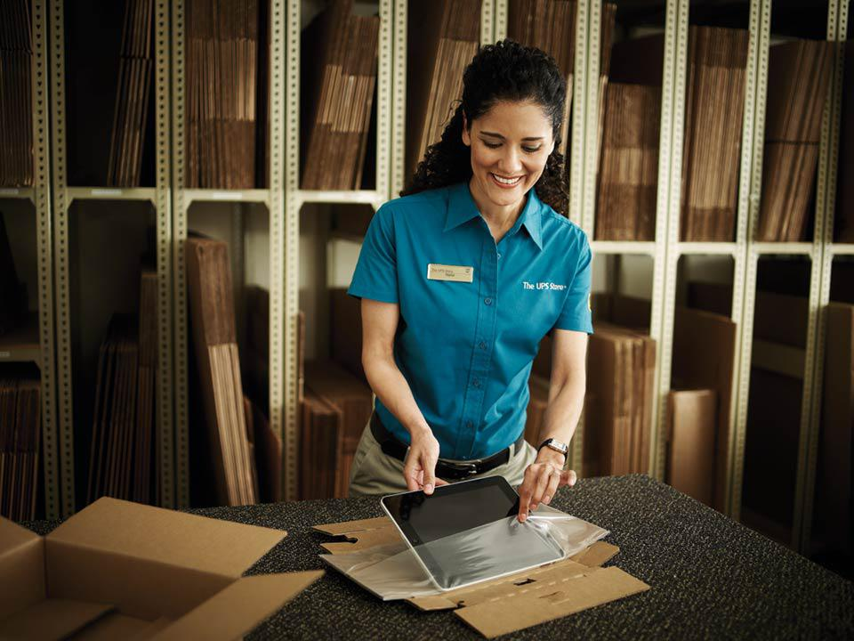
CARE ON HER LUNCH BREAK
Notes:
Patient Story #1: The UPS Store Manager
This was a patient I had at Oscar, her name was Danielle. She really helped me understand some of the challenges that people who enroll in health insurance via exchanges across the nation face. She worked at a UPS Store in Georgia, and signed up for virtual primary care (meaning, I was fully accountable for her care/ outcomes, there was not another PCP somewhere she was also seeing). She first scheduled a video visit with me on her lunch break. Because she was an hourly worker, she did not want to go to any in-person care that wasn’t absolutely critical. I arranged for her to get a PAP smear at an after-hours clinic in her area, and we ordered her other screening tests which she was able to do over a few weeks. I diagnosed her with depression, and ended up managing and titrating her medications using a series of e-Visits. She’d write back to me from work or at night, and we made great progress in getting her symptoms under control. She shared that she had never had a steady doctor before because she could never make it work with her schedule and the impact to her income wasn’t worth it. When I left, I transitioned her care to a Medical Director at Oscar who took over her management along with many other patients on my panel. For Danielle, who needed the income from every hour of work she could get, virtual care and the option for telehealth visits was the only option.

Slide 7
Current Landscape
Notes:
Now we will turn to look at the current landscape of telehealth and virtual care

Slide 8
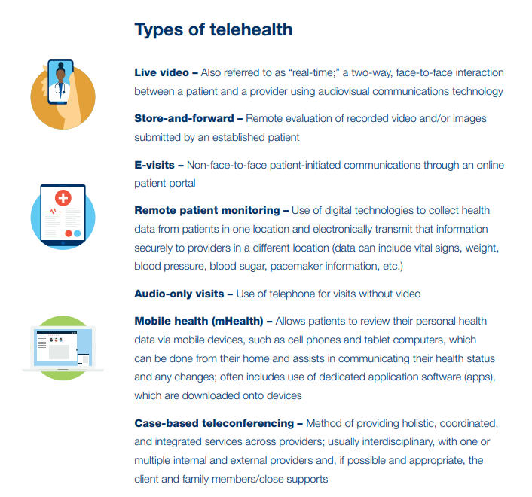
DEFINITIONS
Telehealth: “the use of electronic information and telecommunications technologies to extend care when you and the patient aren’t in the same place at the same time. Technologies for telehealth include videoconferencing, store-and-forward imaging, streaming media, and terrestrial and wireless communications.”
https://www.cms.gov/files/document/telehealth-toolkit-providers.pdf
Notes:
We know that telehealth extends care when a provider and a patient aren't in the same place at the same time period and we know that it takes many forms video store and forward E visits telephone visits and more.

Slide 9
VIRTUAL CARE ACROSS THE CARE DELIVERY SPECTRUM
Virtual Care Solutions
Virtual Modalities Used by Traditional Healthcare Teams
Technology tools (app-based video, chat, text)
Accessible
Limited evidence of quality and safety
Additive to toolkit available ways to connect with patients
Synchronous and async, RPM, eConsult
Growing evidence base for use in both primary + specialty care
Notes:
There are a proliferation of tools and solutions across the healthcare spectrum that constitute virtual care.
First, there are virtual care solutions that include technology tools, they're often app based and prioritize accessibility. There's more limited evidence of their quality and safety as they may often be disconnected from the larger healthcare ecosystem.

Slide 10
DIGITAL TOOLS ACROSS THE CARE DELIVERY SPECTRUM
Virtual Care Solutions
Virtual Modalities Used by Traditional Healthcare Teams
Delivered via technology tools (video, chat, text)
Prioritizes accessibility & flexibility
Small evidence base and lack of research around patient safety & outcomes
Additive to toolkit available ways to connect with patients
Synchronous and async, RPM, eConsult
Growing evidence base for use in both primary + specialty care
Notes:
And then there are virtual or digital modalities or tools used by traditional healthcare teams and these are often additive and one tool in the toolkit of primary care or behavioral health or clinical teams. They may include things like synchronous video visits with unknown care team E consults, eVisits done via a patient portal and there is a growing evidence base for both the use of these tools in primary and specialty care period the key here is that they're connected with a traditional healthcare team

Slide 11
WHAT’S COVERED IN CALIFORNIA?
Coverage Source | Live Video? | Audio Only? | Store and Forward? | Behavioral health? | Parity with In-Person? | Permitted without In-Person Visit?
Medi-cal
Commercial
Medicare |  |  | X
Permitted and reimbursed without restriction
Permitted in certain scenarios
X
Not reimbursed (only in AK and HI)
National Telehealth Policy Resource Center & CMS CY 2025 Proposed Fee Schedule
Notes:
And here we turn to a short summary of what's covered in the state. For the overwhelming majority of Californians right now, 80%+ of whom are covered by medical or commercial insurance video visits audio only visit store and forward technology and virtual care without an in-person visit are all covered under current regulations. Medicare coverage is more limited although there are potential changes coming with the 2025 proposed fee schedule.

Slide 12
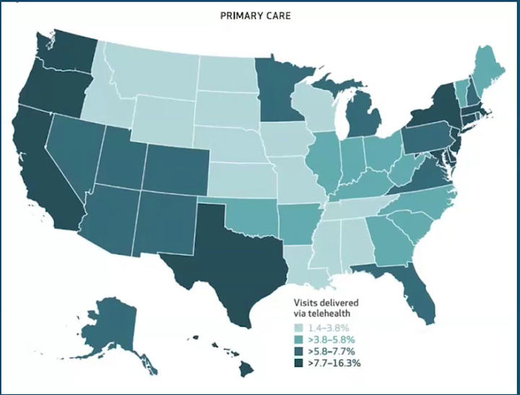
CALIFORNIA PERFORMS A HIGH PORTION OF PRIMARY CARE TELEHEALTH VISITS COMPARED TO OTHER STATES
"Briefing: The Future of Telehealth and Its Impact on Primary Care", Health Affairs Event, September 24, 2024.
Notes:
Whether its in our roles as providers or as patients, California performs a high portion of telehealth visits compared to ther states

Slide 13
A SNAPSHOT OF THE EVIDENCE
Some Good Stuff
Not So Good Stuff
Virtual Care can treat conditions effectively
Evidence for point-of-care ability to treat select conditions at lower cost w/o adverse outcomes (UTI)
Equivalent downstream utilization if PCP uses video visits
Virtual Care can address access challenges and deliver convenient access to care
Serve patients not otherwise engaging with healthcare system
eConsults improve access to Specialty Care for low income and uninsured patients
Point solutions do not deliver care equitably
Virtual Care services are inequitably distributed and utilized
Patients whose preferred language is not English often experience challenges
May increase healthcare costs and ER visits
Virtual Visit with non familiar PCP increases 7d ER rate
Presence of retail clinics (often with virtual component) have not been shown to decrease ER visits
Increasing instability in the retail and tech-enabled clinical models disrupts relationships
Notes:
With all of that telehealth being delivered I wanted to take a moment too acknowledge the evidence. And the evidence is quite mixed think about

Slide 14
Competing Forces in Sustainability

Slide 15
TELEHEALTH SUSTAINABILITY FRAMEWORK
Policy and Payment
Quality & Safety
Operationalization
Payment Model Design
Quality Measurement
Patient Choice
Coverage and Parity
Patient Reported Outcomes and Experience
Workforce Empowerment
Equity
Data Availability & Transparency
Investment in People and Community

Slide 16
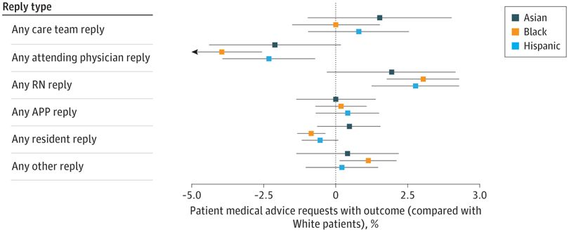
TELEHEALTH SUSTAINABILITY: EQUITY AS FOUNDATION
Not Built Upon Equity
Built Upon Equity
Culturally tailored digital health interventions, such as those that leverage community health workers in conjunction with virtual care tools, can reduce health disparities for patients who identify as Black or African American or Hispanic or Latino.²
Differences in care team response to patient portal messages by patient race and ethnicity¹
Equity
Data Availability & Transparency
Investment in People and Community
Notes:
¹Differences in Care Team Response to Patient Portal Messages by Patient Race and Ethnicity
Mitchell Tang, BA, BS^{1,2}; et al JAMA Netw Open. 2024;7(3):e242618. doi:10.1001/jamanetworkopen.2024.2618
²Katz ME, Mszar R, Grimshaw AA, et al. Digital Health Interventions for Hypertension Management in US Populations Experiencing Health Disparities: A Systematic Review and Meta-Analysis. JAMA Netw Open. 2024;7(2):e2356070. doi:10.1001/jamanetworkopen.2023.56070

Slide 17
TELEHEALTH SUSTAINABILITY: POLICY AND PAYMENT CONSIDERATIONS
Policy and Payment
Payment Model Design
Coverage and Parity

Slide 18
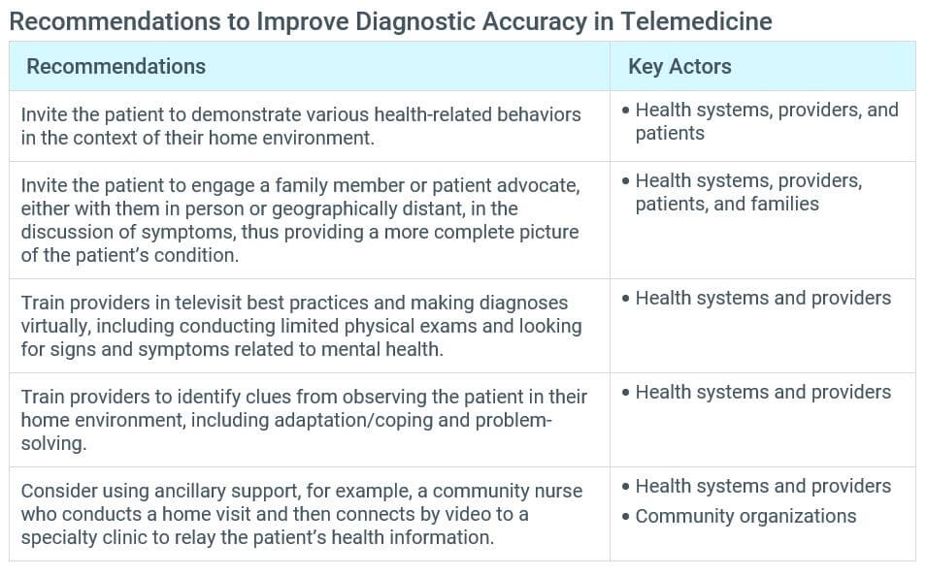
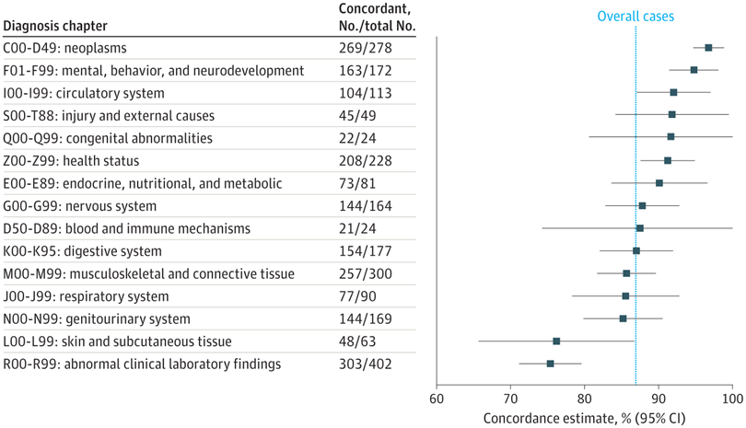
TELEHEALTH SUSTAINABILITY: ADDRESS QUALITY AND SAFETY
Quality & Safety
Diagnostic Accuracy & Quality Measurement
Patient Reported Outcomes and Satisfaction
Perry AF, Federico F, Huebner J. Telemedicine: Ensuring Safe, Equitable, Person-Centered Virtual Care. IHI White Paper. Boston: Institute for Healthcare Improvement; 2021
Demaerschalk BM, Pines A, Butterfield R, et al. Assessment of Clinician Diagnostic Concordance With Video Telemedicine in the Integrated Multispecialty Practice at Mayo Clinic During the Beginning of COVID-19 Pandemic From March to June 2020. JAMA Netw Open. 2022;5(9):e2229958. doi:10.1001/jamanetworkopen.2022.29958

Slide 19
TELEHEALTH SUSTAINABILITY: THE RUBBER MEETS THE ROAD AT THE POINT OF CARE
Operationalization
Seamless Scheduling Workflow
Californians with low-income levels want to the option to use telehealth¹, so what’s stopping them?
Patient Choice
Digital Literacy Screening & Process
Technology that Works
Training and Support for Staff
Workforce Empowerment
Leadership Buy In
¹May 2023 CHCF Report “Telehealth Experience and Preference Among Californians with Low Incomes”
Notes:
Californians with low-income levels <200% FPL:
Want telehealth to be an integral part of their care
Preference for modality (phone, video, in-person) is very personal
Want to choose or decide with provider which type of visit makes sense for them

Slide 20
Overview of Covered California

Slide 21
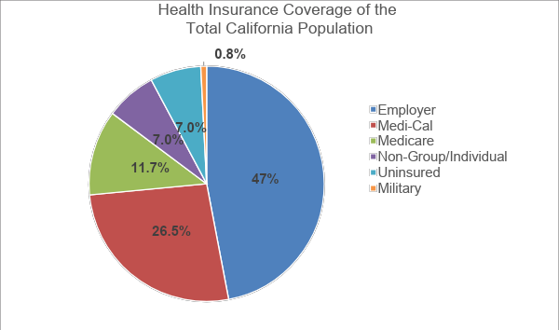
MORE COVERAGE FOR CALIFORNIANS
The Affordable Care Act has dramatically changed the health insurance landscape in California with the expansion of Medicaid, Covered California and new protections for all Californians.
Kff.org
Notes:
I’d like to share a little bit more about Covered California and our role in the California healthcare coverage landscape. Almost ½ of all Californians receive coverage through their employers, another 1/3 are covered based on Medi-cal based on income, and 12% are covered by Medicare. Prior the Affordable Care Act, California’s uninsured rate was near 15%.
With Covered California, the uninsured rate is down to 6-7% in recent years as over 1.7 million people are able to buy commercial health insurance through the state based marketplace

Slide 22
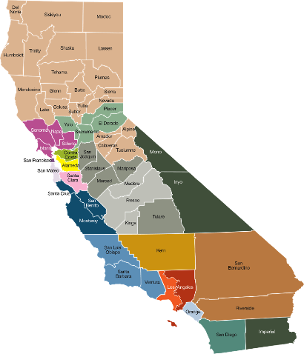
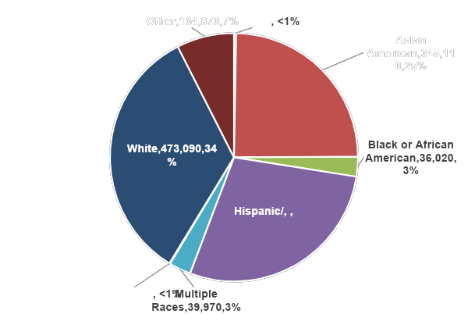
COVERED CALIFORNIA AT A GLANCE
Enrollment Reflecting
California’s Diversity
Covered California
by the Numbers 2024
AI/AN
12
Carriers
1.74 Million
Enrollees
88%
Subsidized
NH/PI
‹#›
Notes:
Covered California provides a place to connect Californian’s with high quality affordable health plans, offered by these insurers and gets them connected to financial assistance.

Slide 23
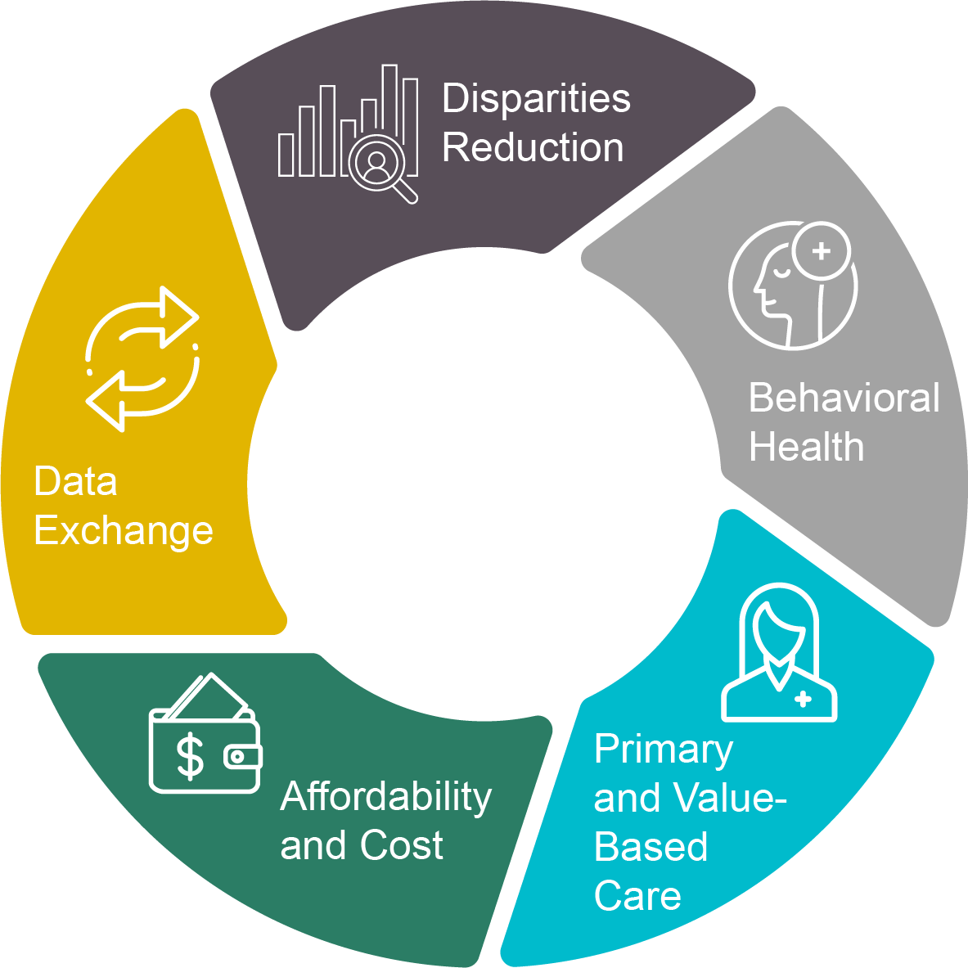
COVERED CALIFORNIA: A TRUE ACTIVE PURCHASER
Negotiation of premiums
Standardized benefit designs
Selective contracting for quality (with ability to remove low-performers from the Exchange)
Certification for new entrants depends on meeting requirements in multiple domains
Alignment
with DHCS
and CalPERS
2023-2025 QHP Issuer Contract Areas of Focus
Notes:
CCA Is more than a marketplace

Slide 24
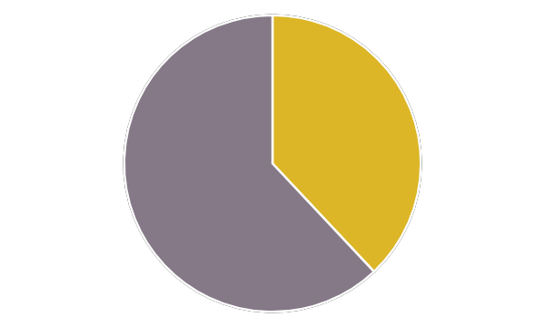
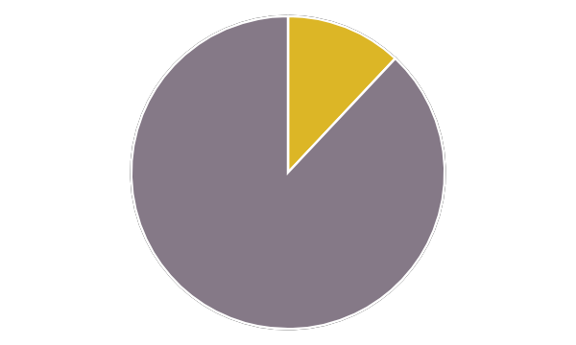
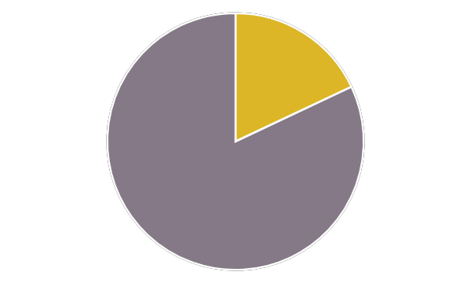
Snapshot of Covered California Enrollees
Covered California enrollees have a high prevalence of medical, mental health, and social health needs and a short duration of enrollment.
14
months
38% of all enrollees have a chronic condition
12% of all enrollees have a mental health diagnosis
18% of all enrollees live in Healthy Places Index lowest Quartile
Average duration of enrollment on Covered California plans
2022 on-exchange member data from Health Evidence Initiative all plan claims database

Slide 25
Covered California’s Approach to Quality & Equity

Slide 26
THE PROBLEM
Proliferation of quality measures
Clinician administrative burden
Stagnant or worsening quality outcomes
Persistent health disparities

Slide 27
APPROACHES TO ISSUER ACCOUNTABILITY FOR QUALITY AND EQUITY
Dashboards and Public Reporting
Improvement Plans
Financial Incentives
Notes:
Reporting, disparities reduction, financial accountability

Slide 28
AN ALIGNED STATE-WIDE APPROACH
Medi-Cal 15 million
California Public Employees’ Retirement System 1.5 million
Covered California 1.7 million
Collectively cover over 45% of all Californians

Slide 29
QUALITY TRANSFORMATION INITIATIVE
Make Quality Count
Measures that Matter
Equity is Quality
Amplify through Alignment
0.8% to 4% premium
at risk for
a small set of clinically important measures
stratified by race/ethnicity
selected in concert with other public purchasers*
*Public purchasers includes CalPERS and DHCS/Medi-Cal

Slide 30
COVERED CALIFORNIA REQUIREMENTS FOR TELEHEALTH AS CORNERSTONE TO ACCESS
Telehealth coverage requirements
Public reporting on utilization & disparities
Annual reporting on telehealth promotion
Analysis of utilization patterns and outcome measures
Culturally appropriate telehealth services & interpreters
Focused requirements for behavioral health telehealth

Slide 31
Trends and Disparities in Telehealth Use

Slide 32
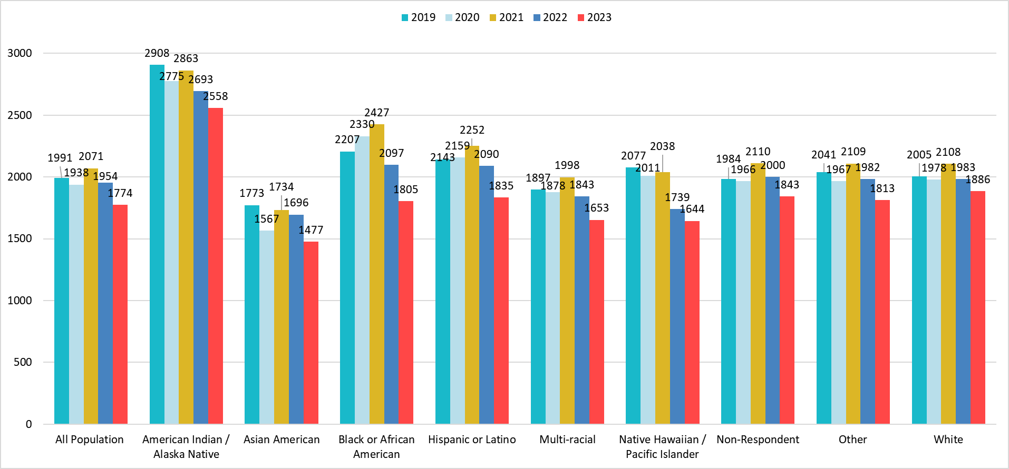
ALL POPULATION PERFORMANCE Primary Care Visits per 1000 Members by Race/Ethnicity
HEI
Notes:
Let’s start by looking at overall primary care visit trends – the set of columns all the way to left is the all population trend, YoY. You can see overall, PC visits are declining. This slide should be in your deck so you can look more closely at disparities when we disaggregate this data by race and ethnicity groups, members who identify as AI/AN have higher rates of PC visits overall, and members who identify as Asian American have lower rates. And, across all groups, we see a decline since 2021 in the PC visit rates.

Slide 33
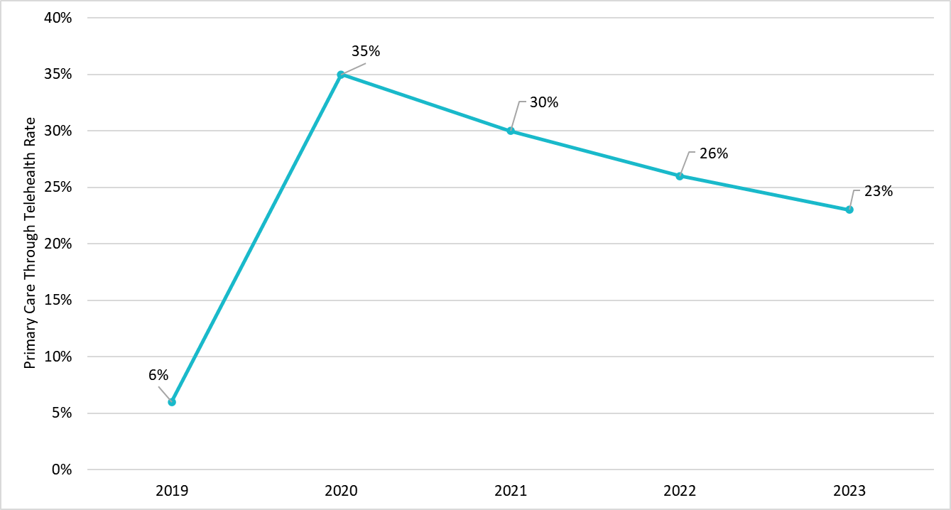
ALL POPULATION PERFORMANCE Primary Care Through Telehealth Over Time
HEI
Notes:
What portion of those visits are delivered via telehealth?
We know there was a spike during COVID, and there’s been a steady decline YoY

Slide 34
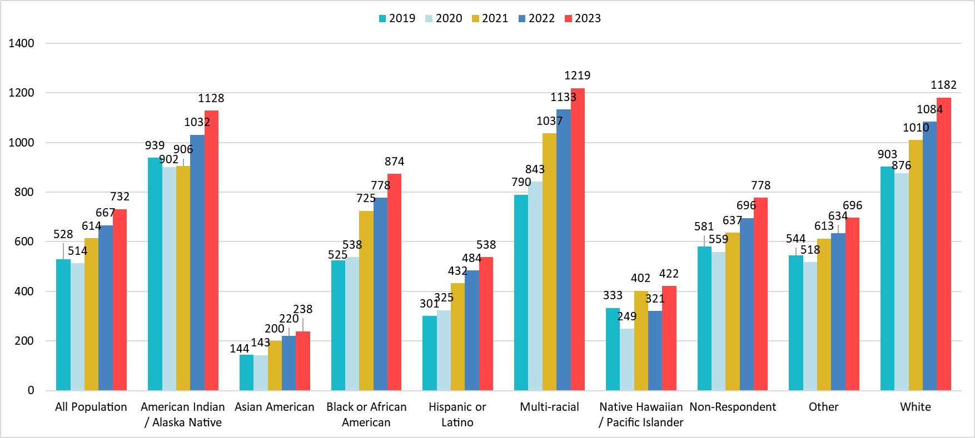
COVERED CALIFORNIA Behavioral Health Visits per 1,000 Members by Race/Ethnicity
HEI
Notes:
Now let’s turn to BH
We see a very different trend.
BH visits continue to steadily increase YoY, both for the all population and when we look across race and ethnicity groups

Slide 35
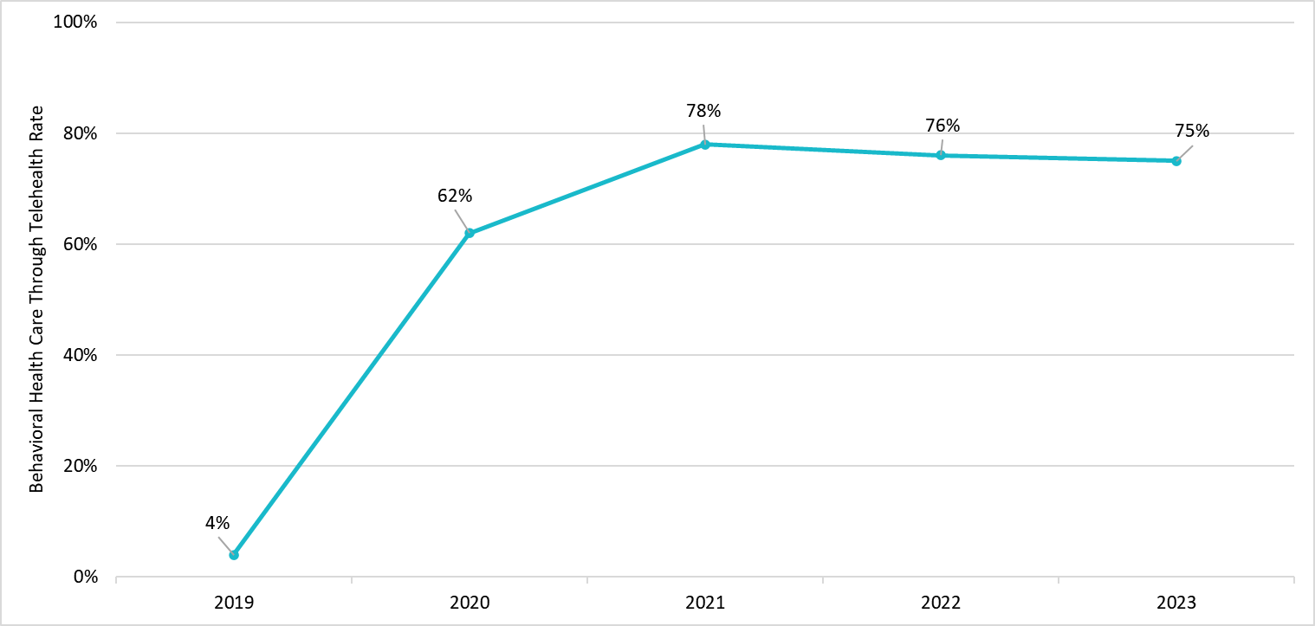
ALL POPULATION PERFORMANCE Behavioral Health Care Through Telehealth Over Time
HEI
Notes:
And, telehealth is persistently used for a great majority of BH telehealth for CCA Members – 75% of BH visits were done via telehealthi n 2023

Slide 36
Policy Versus Reality: We’re All Advocates

Slide 37
MOVING FORWARD AS ADVOCATES
Policy
Reality
Virtual Care modalities are widely available and reimbursed across payer types
Virtual Care is inequitably distributed, deployed, and utilized
How might we bridge this gap?

Slide 38
MOVING FORWARD AS ADVOCATES
Policy
Reality
Insurers cover virtual care solutions for their members and often incentivize their use
If disconnected from the larger healthcare landscape, virtual care may have deleterious effects
How might we bridge this gap?

Slide 39
NEXT STEPS: COVERED CALIFORNIA’S APPROACH
Contribute to the Body of Evidence that Supports High Quality, Equitable Virtual Care
Conduct research & publish data that measures virtual care uptake and efficacy across settings
Support and apply standards for virtual care quality and expectations (e.g., NCQA Virtual Care standards)
Engage with Policymakers to Advocate for Equity
Examine policies and proposed rules with an equity-first lens
Respond to proposed changes in policy in formal public comment period (e.g., CMS’ proposed fee schedule rule)
Educate People about Coverage Rights and Escalation Pathways
Incentivize and support the use of telehealth navigators and digital literacy efforts with the same degree of investment as technology itself (e.g., contract provisions)
Post and publicize pathways for patients to escalate their concerns (e.g., DMHC pathways)

Slide 40
TELEHEALTH SUSTAINABILITY FRAMEWORK
Policy and Payment
Quality & Safety
Operationalization
Payment Model Design
Quality Measurement
Patient Choice
Coverage and Parity
Patient Reported Outcomes and Experience
Workforce Empowerment
Equity
Data Availability & Transparency
Investment in People and Community

Slide 41
Thank you!

Slide 42
Barbara Rubino Barbara.Rubino@covered.ca.gov

Slide 43
Welcome
Libby Sagara
Managing Director BluePath Health
Mei Kwong, JD
Executive Director Center for Connected Health Policy
© California Telehealth Policy Coalition and E-Consult Workgroup, 2024

Slide 44
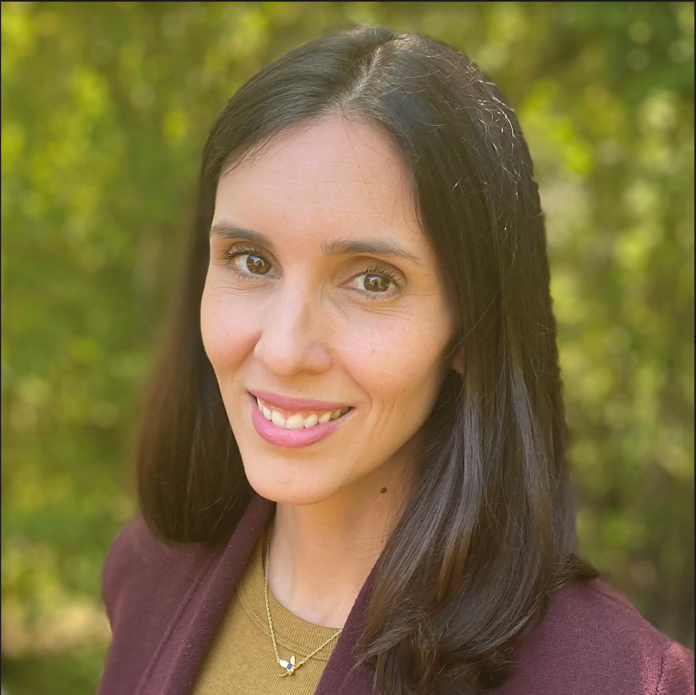
Celebrating Our Work
Diana Camacho, MPH,
Senior Program Officer, California Health Care Foundation
© California Telehealth Policy Coalition and E-Consult Workgroup, 2024

Slide 45
Today’s Agenda
Session | Time
Breakfast | 9:30 am
Keynote Address | 10:00 am
Morning Sessions | 10:30 - 12:00 pm
Lunch and Technology Showcase | 12:00 - 1:00 pm
Afternoon Sessions | 1:00 - 4:00 pm
Wrap Up and Thank Yous | 4:00 pm
Reception at Cafeteria 15L | 5:00pm
*Please find a detailed agenda in today’s materials, posted to the E-Consult Workgroup website.
© California Telehealth Policy Coalition and E-Consult Workgroup, 2024

Slide 46
Thank you to our sponsors!
© California Telehealth Policy Coalition and E-Consult Workgroup, 2024

Slide 47
CMMI Perspective: Innovation at the Federal Level
Kate Davidson, LCSW
Learning and Diffusion Group,
Center for Medicare and Medicaid Innovation
© California Telehealth Policy Coalition and E-Consult Workgroup, 2024

Slide 49
Overview |CMS Innovation Center Statute
“The purpose of the [Center] is to test innovative payment and service delivery models to reduce program expenditures…while preserving or enhancing the quality of care furnished to individuals under such titles”
Three scenarios for success:
Quality improves; cost neutral
Quality neutral; cost reduced
Quality improves; cost reduced (best case)
A model that meets one of these three criteria (and other statutory prerequisites), can be expanded in duration and scope through rulemaking

Slide 50
Overview | Lessons Learned from the Past 10 Years
Not enough focus on health disparities or Medicaid
Too many models, some of which overlap
Voluntary models result in increased spending due to risk selection
Too many providers reluctant or unable to accept downside risk
Challenges in setting appropriate financial benchmarks have undermined models’ effectiveness
Statutory bar for success of models (certification) is high
Appropriate focus on provider and health system input but lack of patient or beneficiary perspective

Slide 51
Current Priorities & Progress | Strategy Refresh
Five Strategic Objectives:
Example: primary care models to improve patient navigation
Examples: ACO REACH benchmark adjustment; new incentives for safety net providers
Examples: practice-specific data, payment flexibilities, peer learning collaboratives
Examples: Part D Senior Savings model; proposed Medicare $2 drug list
Example: AHEAD state total-cost-of-care model

Slide 52
CMS Innovation Center Strategy Roadmap| 2023 - 2030
External Engagement & Learning
Health Care Payment Learning and Action Network (LAN) State Transformation Collaboratives, Health Equity Advisory Team, Accountable Care Action Collaborative, Person Perspectives Council, National Plan Workgroup
Listening Sessions and Webinars Engaging beneficiary and provider perspectives across the model life cycle, informing new model development and cross-model priorities
2023
2024
2025-2029
New Models Announced:
Making Care Primary (MCP)
Guiding an Improved Dementia Experience (GUIDE)
States Advancing All-Payer Health Equity and Development (AHEAD)
Transforming Maternal Health (TMaH)
New Models Announced¹: Innovation in Behavioral Health (IBH), Cell & Gene Therapy Access Model (CGT)
New Model Launches: MCP, GUIDE, AHEAD, IBH
Model Concepts Under Development:
Population- and condition-specific models
ACO model tests (e.g., primary care prepayment)
Episode-based payment and specialty care models
Models to lower prescription drug costs, including the Medicare $2 Drug List (M2DL)
New Model Launches: CGT, TMaH, M2DL
New Concepts Under Consideration:
Additional ACO model tests and other policy initiatives to achieve 2030 accountable care goals
Specialty integration models
Health Plans and Prescription Drugs
Cross-Model Priorities
Person-Centered Quality
Multi-payer Alignment
Transparency, Interoperability, and Data Sharing
Health Equity
Measuring Transformation Impacts

Slide 53
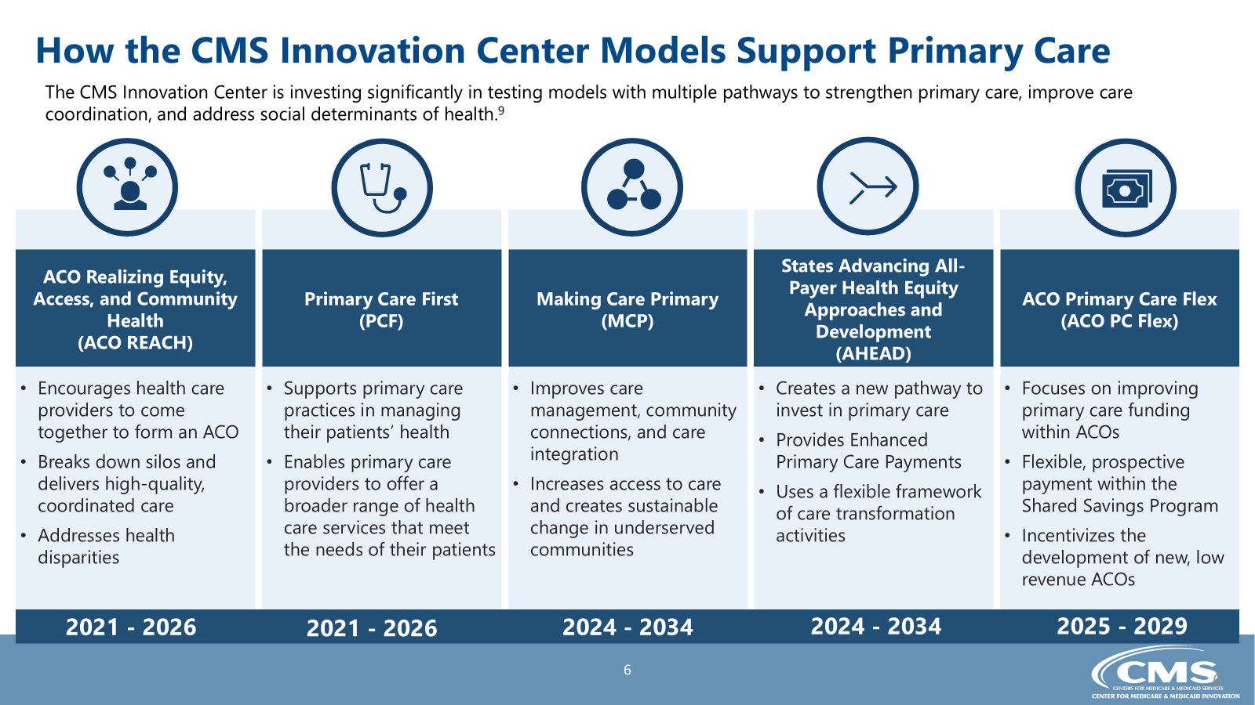
How the CMS Innovation Center Models Support Primary Care
The CMS Innovation Center is investing significantly in testing models with multiple pathways to strengthen primary care, improve care coordination, and address social determinants of health.⁹
Encourages health care providers to come together to form an ACO
Breaks down silos and delivers high-quality, coordinated care
Addresses health disparities
Supports primary care practices in managing their patients’ health
Enables primary care providers to offer a broader range of health care services that meet the needs of their patients
Improves care management, community connections, and care integration
Increases access to care and creates sustainable change in underserved communities
Creates a new pathway to invest in primary care
Provides Enhanced Primary Care Payments
Uses a flexible framework of care transformation activities
Focuses on improving primary care funding within ACOs
Flexible, prospective payment within the Shared Savings Program
Incentivizes the development of new, low revenue ACOs
ACO Realizing Equity, Access, and Community Health
(ACO REACH)
States Advancing All-Payer Health Equity Approaches and Development
(AHEAD)
Primary Care First
(PCF)
Making Care Primary
(MCP)
ACO Primary Care Flex
(ACO PC Flex)
2021 - 2026
2021 - 2026
2024 - 2034
2024 - 2034
2025 - 2029
‹#›

Slide 61
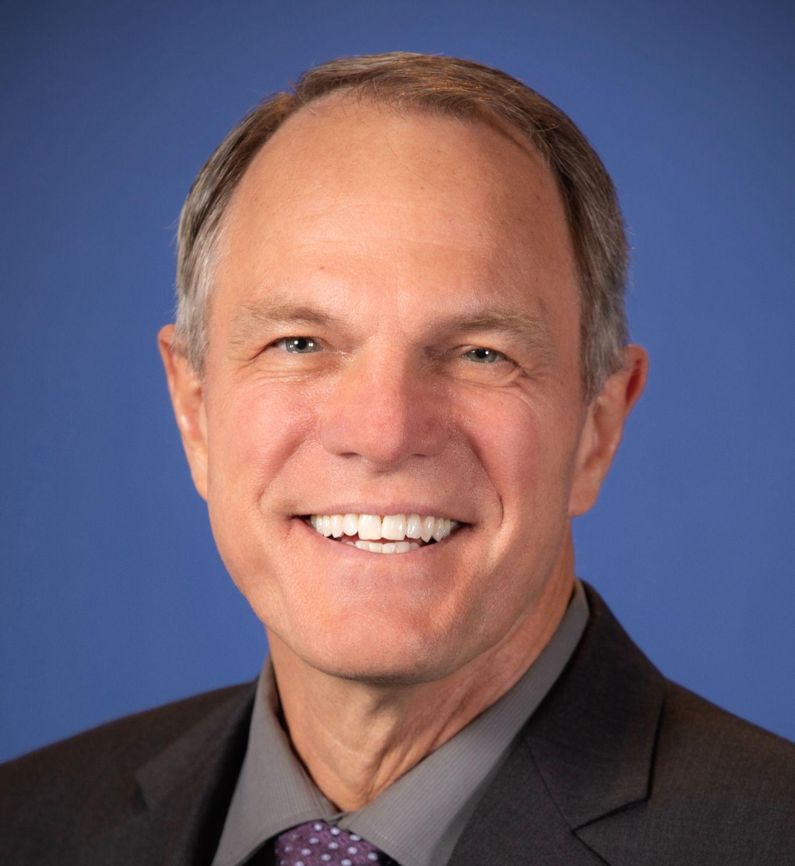
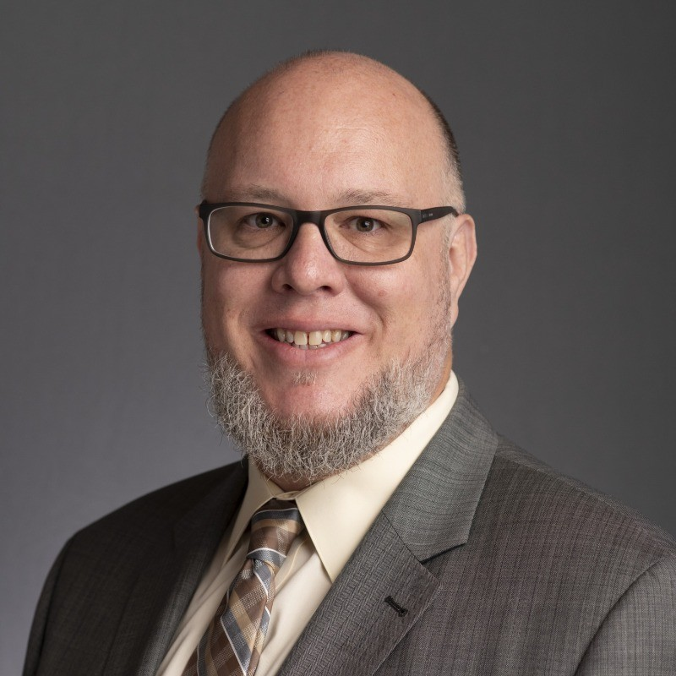
Telehealth Ted Talks
James Marcin, MD, MPH,
Professor, Pediatric Critical Care, Director, Center for Health and Technology, UC Davis Health
Micah Matthews, MPA, CPM, Deputy Executive and Legislative Director, Washington Medical Commission
© California Telehealth Policy Coalition and E-Consult Workgroup, 2024

Slide 62
Telehealth and eConsultations…. Jim Marcin jpmarcin@ucdavis.edu

Slide 63
A Story…
2000: Grant for Telemedicine
California Healthcare Foundation
Install Telemedicine in 3 Rural EDs

Slide 64
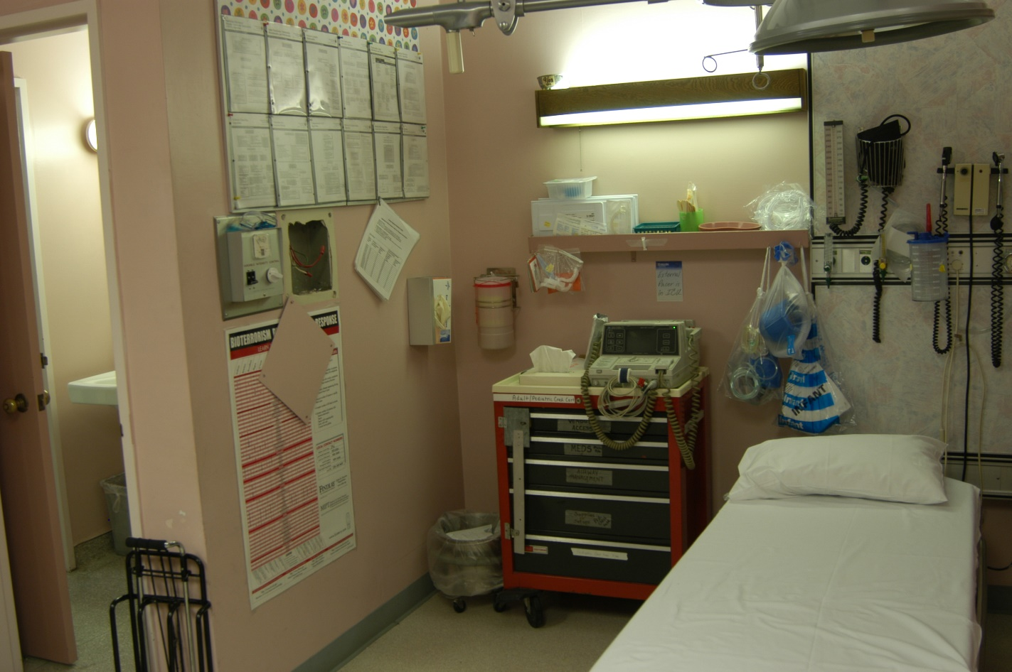
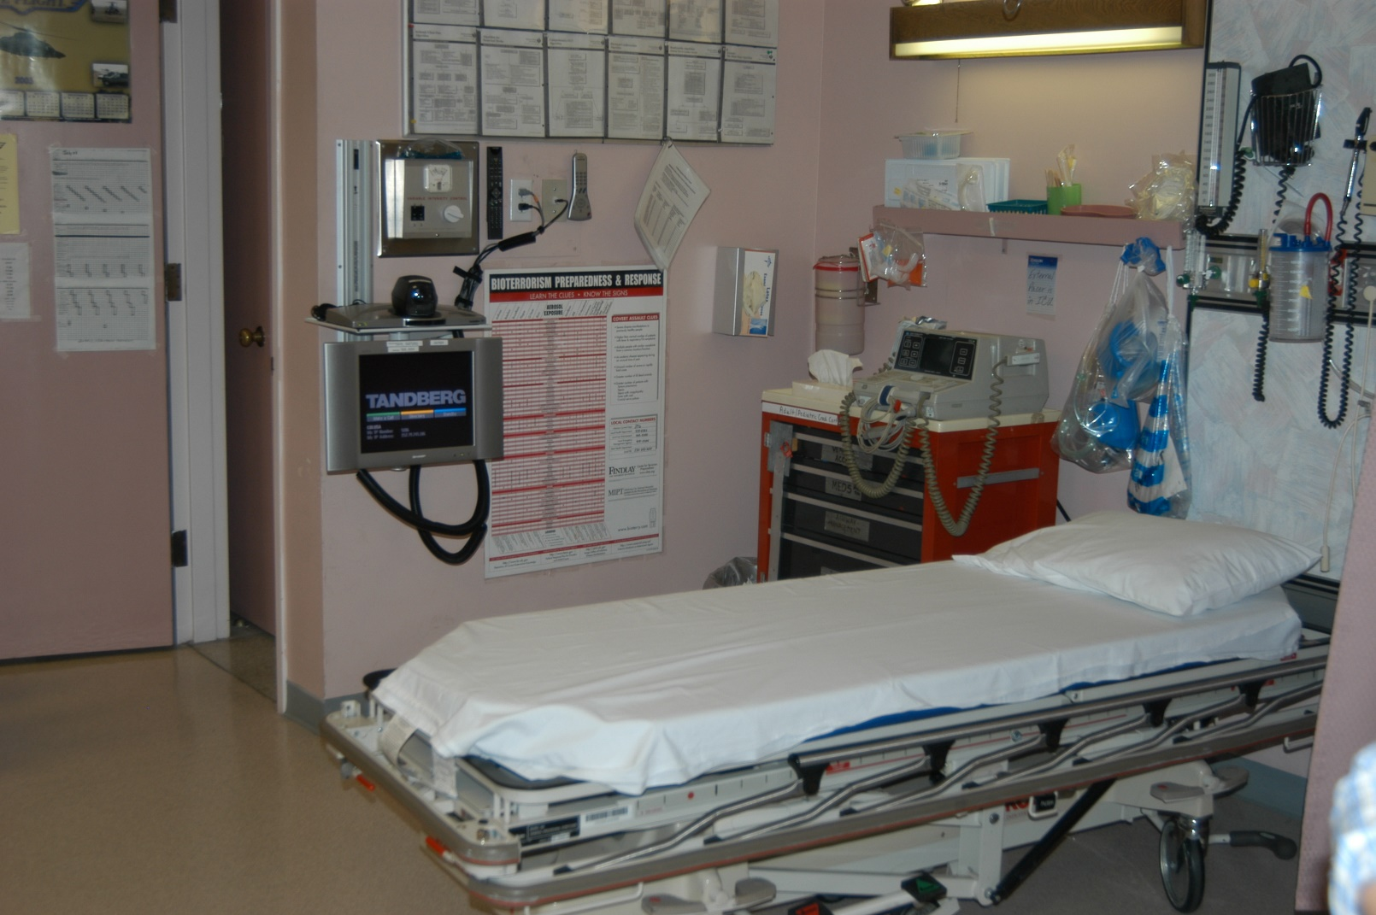
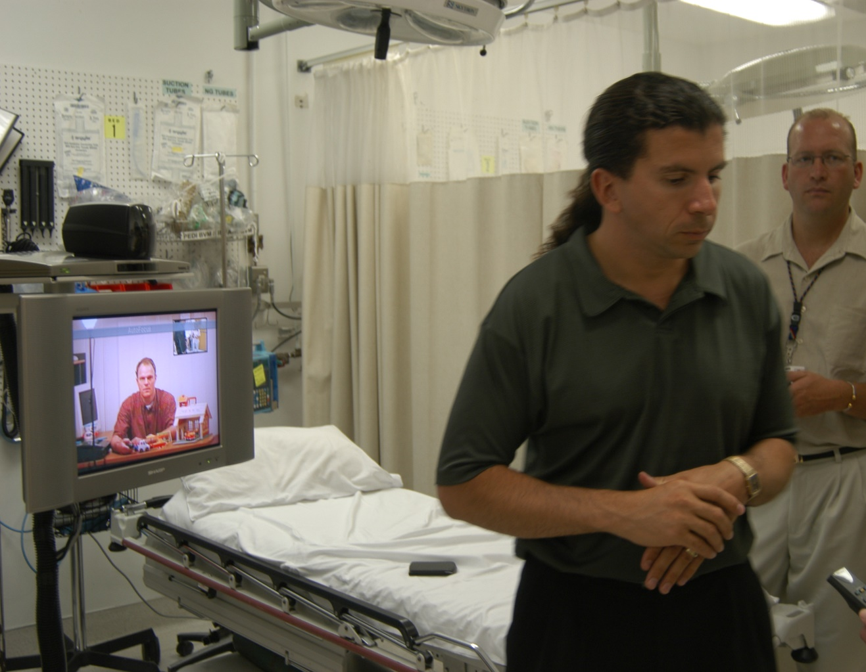
Colusa Regional Medical Center

Slide 65
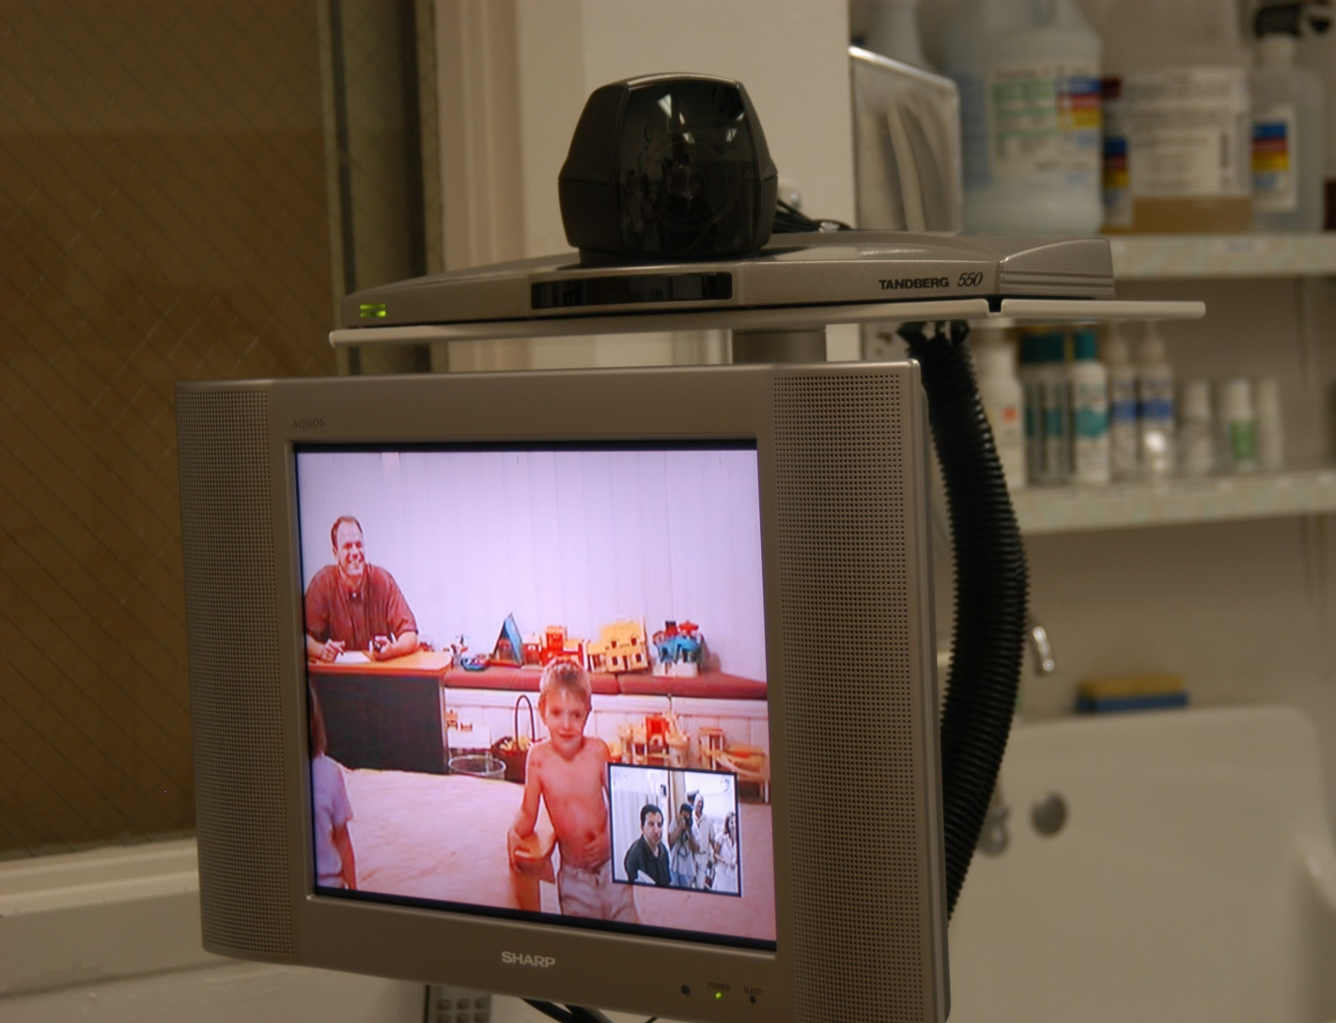
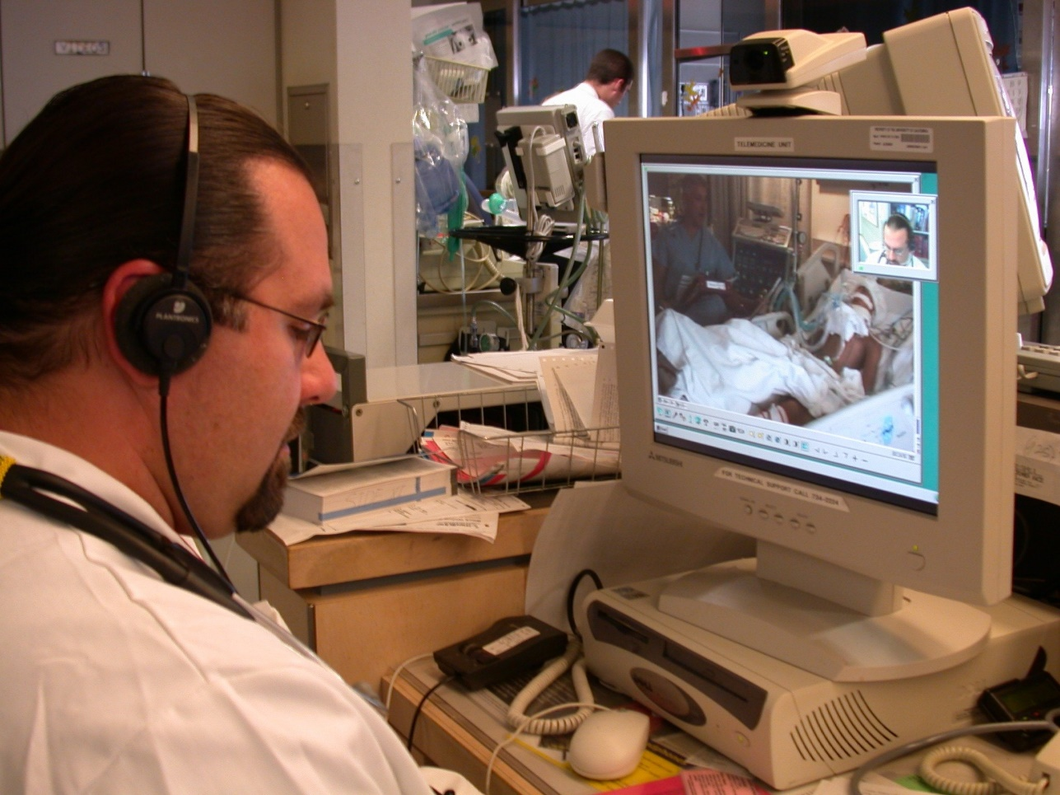
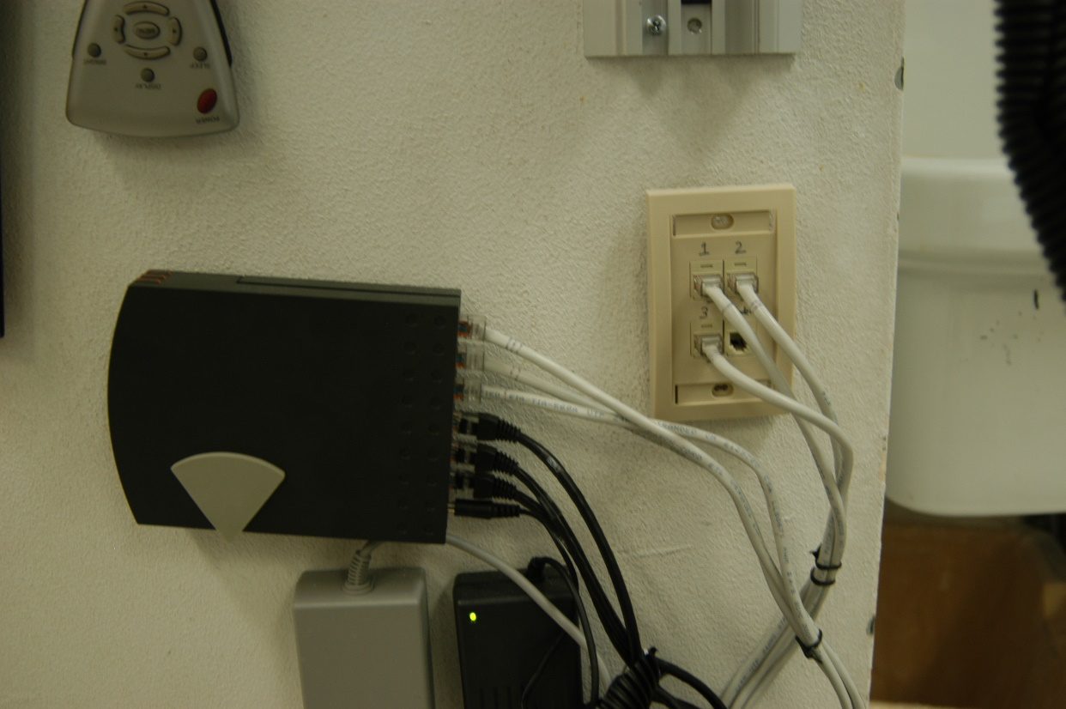
Colusa Regional Medical Center

Slide 66
Colusa Regional Medical Center
Christmas Day, 2001
The gift of telemedicine…

Slide 67
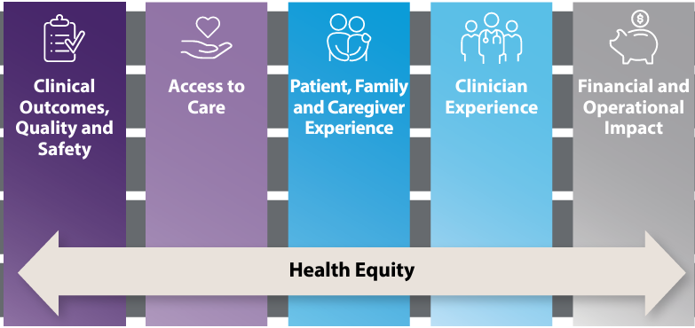
The Promise of Telehealth
Return on Health:
Moving Beyond Dollars and Cents in Realizing the Value of Virtual Care

Slide 68
Epic data from:
1,272 hospitals and more than 27,200 clinics
>476,000,000 Encounters
220 million patient records
All 50 states and Lebanon

Slide 69
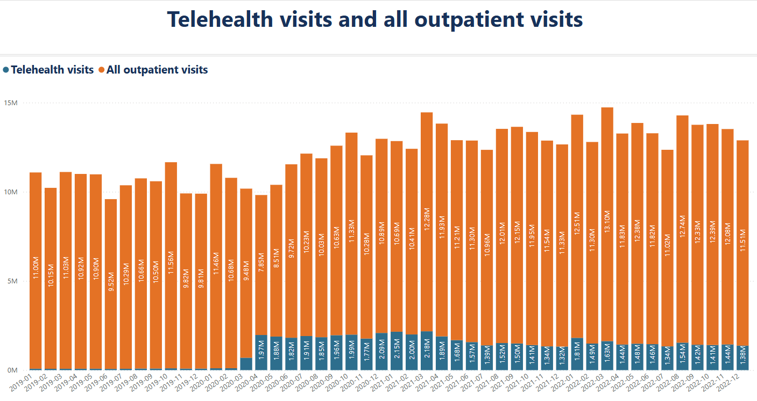
DHCS Telehealth Dashboard

Slide 70
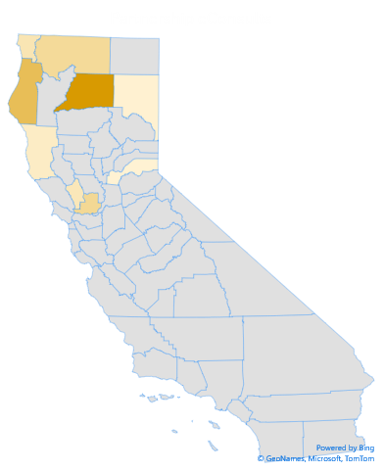
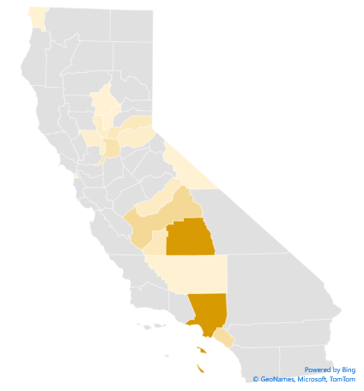
Teleheatlh & eConsultations Part of UC Davis Health
18% of all ambulatory visits
Internal hospital telehealth
66 connections to hospitals
>3,500/year
18 connections to clinics
>1,200/year to FQHC, RHC, IHS
Express Care: 50-80/day
Remote Patient Monitoring
Internal, External eConsultations
Notes:
Use ”New Slide” or “Layout” to view and customize the slide templates.

Slide 71
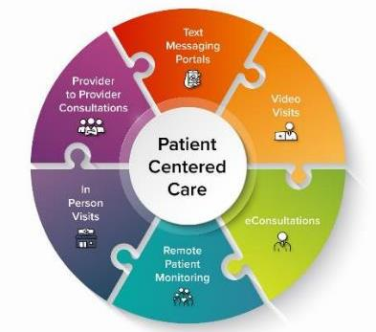
Telehealth: Not a Replacement for In-person
The Right Patient, Modality, Condition, Circumstance
Telephone
eMessaging / Texting / eVisits
eConsultations
Asynchronous models of care
Video Visits (Provider-Patient)
Telehealth Specialist Clinic (Prov-Prov)
Remote Patient Monitoring
In Person Care

Slide 72
Thoughtful Implementation
Study of CalPERS Telehealth
Lower adherence to evidence-based guidelines
88% of DTC considered “new utilization” & increased costs
Activity Trackers
Associated with less weight loss
RPM not always associated with reduction in clinic/ED visits
Uscher-Pines L, et al. Access and Quality of Care in Direct-To-Consumer Telemedicine. Telemed J E Health 2016
Ashwood JS, et al: DTC Telehealth May Increase Access To Care But Does Not Decrease Spending Health Affairs; March 2017
Jakicic JM, et al: Effect of Wearable Technology Combined With a Lifestyle Intervention on Long-term Weight Loss: The IDEA Randomized Clinical Trial. JAMA 2016
Spring B, et al: An Adaptive Behavioral Intervention for Weight Loss Management A Randomized Clinical Trial. JAMA 2024
Cooper BM, et al: Telehealth Home Monitoring and Postcardiac Surgery for Congenital Heart Disease Pediatrics. 2020
Iqbal FM, et al: Clinical outcomes of digital sensor alerting systems in remote monitoring: a systematic review and meta-analysis. NPJ Digital Medicine 2021
Taylor ML, et al: Does remote patient monitoring reduce acute care use? A systematic review. BMJ Open 2021
Notes:
Use ”New Slide” or “Layout” to view and customize the slide templates.

Slide 73
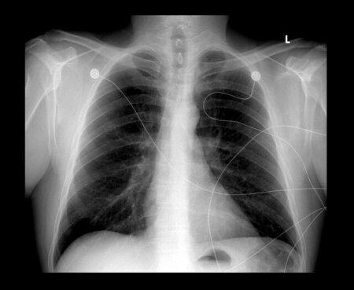
Thoughtful Implementation
Care Management Software (Optum) AI to identify “High Risk” patients
Black patients 17.7 to 46.5% less likely to receive additional help
Machine Learning for diagnosing COVID-19
2,212 articles reviewed
62 included in systematic review
None clinically usable
Obermeyer: Dissecting racial bias in an algorithm used to manage the health of populations. SCIENCE Oct 2019
Roberts: Common pitfalls and recommendations for using ML to detect and prognosticate for COVID-19 using chest radiographs and CT scans. Nature Machine Intelligence 2021

Slide 74
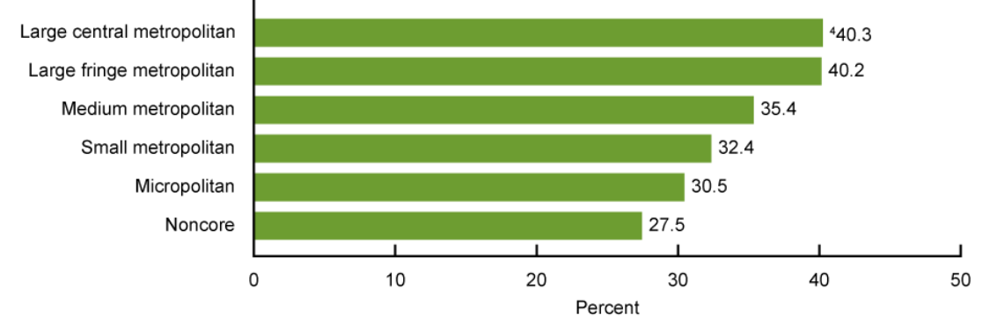
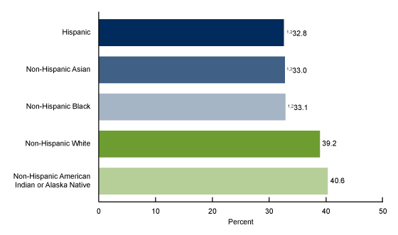
Digital Health Equity

Slide 75
Thank You!!
Jim Marcin jpmarcin@ucdavis.edu

Slide 76
Lunch Graphic
Meet us at 12:15 for TTAC Technology Presentation
© California Telehealth Policy Coalition and E-Consult Workgroup,
2024

Slide 77
Technology Showcase
Annual Meeting of the California Telehealth Policy Coalition and E-Consult Workgroup
Annual Meeting of the California Telehealth Policy Coalition Conference
Nov. 19, 2024
Calvin Ross, Technology Specialist
Telehealth Technology Assessment Center
cmross@anthc.org
Notes:
Introduce myself: keep it light, Technology specialist here with TTAC

Slide 78
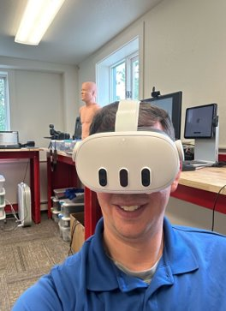
Who is TTAC?
TTAC is federally funded through the Office for the Advancement of Telehealth (OAT)
TTAC provides Technology Assessment services to the 12 regional TRCs as well as the other national TRC.

Slide 79
Notes:
12 Regional Telehealth Resource Centers; with California Telehealth Resource Center for California.
2 National TRC’s one focused on Policy: Center for Connected Health Policy, CCHP
Other national TRC is TTAC: focused on Telehealth Technology

Slide 80
National Consortium of Telehealth Resource Centers
Our website hosts many resources. If you can’t find what you’re looking for, contact your regional TRC:
www.TelehealthResourceCenter.org
Notes:
We are a member of the National Consortium of Telehealth Resource Centers.

Slide 81
What do we do?
Individual and Organizational Technical Assistance
Website Resources:
Innovation Watch
Technology Toolkits
Special Projects:
Telehealth Technology Survey
Telehealth Broadband Pilot Program
Telehealth Technology Showcase
Notes:
We provide several services: first of all, we provide technical assistance free of charge to individuals and Organizations regarding their Telehealth Technology needs.
Beyond that we have our website that features multiple resources but are centered around Toolkits (larger topical discussions on Technology, and Innovation watches, which are highlights of specific pieces of technology that are deemed as bring something new or innovative to the marketspace.
We have two ongoing special projects: One is our Telehealth Technology Survey and our Telehealth broadband pilot program.
Our survey which is conducted every two years to determine Technologies of interest for Evaluations, toolkits, and videos. Understanding the effect of new technologies on Telehealth at the regional and nation level and finally determining how we can best engage with our audience. This most recent survey was completed in March of this year and the survey results have been published on our website for review.
Our Telehealth Broadband Pilot Program is a grant funded project in which TTAC developed a broadband measuring device and deployed them to rural counties in 4 specific states: Texas, West Virginia, Michigan, and Alaska. This project is coming to a close and we should soon have a study paper and a website dedicated to the project’s findings.

Slide 82
What did I bring today?
No endorsement of any products or services is expressed or implied by any information but are examples of technology that is currently on the wider marketspace. TTAC has no financial ties with any products highlighted.
Notes:
TTAC is interested in technology and determining how it is to be used in Telehealth. As we are Federally funded, non of the specific devices mention today in the presentation or featured in the showcase are an endorsement of these products, but rather representative of the type of technologies available on the market.

Slide 83
Showcase Focus
Telehealth Evolution:
-More personalized
-AI Enhanced
-On-Demand
-On-the-Go
Notes:
Today we are featuring these types of technologies.
The reason that these devices were selected is that they represent some new trends in Telehealth.
-Focused on the patient
-Optimized experience due to AI
-Deliver care when and where it is need

Slide 84
Showcase Items
Types of technology:
Rugged Telemedicine Case
AI-Enhanced Cameras
AI-Enhanced Cardiology
Multi Exam Devices
Notes:
Today we are featuring these types of technologies.
The reason that these devices were selected as they represent some new spaces in Telehealth.
We do these showcases so you can see and feel these devices and determine for yourself what they can do and what potential benefit they might provide to you or your organization.

Slide 85
Rugged Telemedicine Case
Manufacturer:
-AMD Telemedicine
Key Features:
-Windows Tablet based
-Multiple USB Ports
-Integrated storage and compartments
-Multiple lensed exam camera storage
Practical uses in Telehealth:
-Traveling nurse, Community-Based Medicine, School Environments
Notes:
Telehealth cart in case
-The use of traditional telehealth devices in a portable form-factor.
-Bringing the Telehealth cart to the patients.
-Backpack form factors.

Slide 86
AI Enhanced Cameras
Device and Manufacturer:
-Obsbot Tail Air
Key Features:
-Pan-Tilt-Zoom
-Live Stream focused
-Tablet, phone, or
computer-controlled
Practical uses in Telehealth:
-Mobile Telehealth kits/carts
-Pop-up Clinic space
Device and Manufacturer:
-iPevo Totem 120
Key Features:
-Document Camera
-Conference room mode
-AI Human tracking
Practical uses in Telehealth:
-Educational trainings
-Printed document review
-Speech pathology
Notes:
AI-Human tracking: Human faces and body shapes
AI is getting good at recognizing human faces vs. other objects.
This enhancement is starting to saturate the webcam market space for more premium devices.
Here are two examples:
Obsbot:
-Battery-powered mobility
-Various output formats
iPevo:
Document camera: digitizing physical media
AI Human Tracking and Noise isolation
Speech pathologist: using flashcards, and seeing the provider’s mouth to help patients make the correct sounds

Slide 87
All-in-One Exam Devices
Device and Manufacturer:
-Medwand Exam device
Key Features:
-Multiple Exam types: Thermometer, SpO2, Stethoscope, ECG, Otoscope/Exam camera.
-Deep EHR Integration
-Clinical focused
Practical uses in Telehealth:
-Skilled nursing, Concierge medicine, At-home exams, Rural communities
Device and Manufacturer:
-Tyto Pro Clinic
Key Features:
-Multiple exam types:
Otoscope, Exam Camera, Thermometer, and Stethoscope
-Stand-alone or integrated EHR
-Can be user-driven
Practical uses in Telehealth:
-Schools, Worksites, At-home exams, Rural Communities, Senior Care Facilities
Notes:
Medwand: -Tablet/Smartphone based
-Allows for the provider to drive exams remotely
-USB-C wired connection, no pairing of device
-No battery to charge
-Live/Asynchronous Exam
-Size of a computer mouse
Tyto: -Tablet/Smartphone based
-integrated patient self-guidance
-Live visit/Asynchronous Exam
-Can be user-driven

Slide 88
AI-Enhanced Cardiology
Device and Manufacturer:
-Kardia Mobil 6L
Key Features:
-Bluetooth to phone/tablet
-AI analysis and Kardia Provider review with KardiaCare membership
-Affordable price for device, membership per month
Practical uses in Telehealth:
-Patient self monitoring
Device and Manufacturer:
-EKO Core 500 Digital Stethoscope
Key Features:
-Bluetooth pairing to Phone/Tablet, or Web app
-3 Lead EKG with Built-in Display
-EKO-AI analysis
Practical uses in Telehealth:
-General exams
-Live/Store-Forward
Notes:
Kardia:
-Coin battery-operated
-12-month typical battery life
-Simple no buttons
-Allows for users to get INSTANT access to a cardiologist to provide feedback if they are having an episode
-Alert circle of contacts if abnormalities are detected
EKO:
-EKO-AI including potential murmurs, AFib, or other abnormalities detected
-Traditional form factor
-USB-C charge
-3.5 mm jack for Aux input or Earpiece
-Flexible/Customized pricing structure for Telehealth implementation

Slide 89
Telehealth Technology Takeaways
Care specific to the individual
AI-Enhancement at multiple levels
Telehealth when and where it’s needed
Aware of the patient's environment and physical location
Notes:
Telehealth technology is about eliminating barriers in connecting to our patients remotely.
One of the big takeaways that we wanted to leave you with today are that Telehealth continues to evolve to be more portable and increasingly based on mobile device platform: like tablets, smart phones, and other devices.
AI-Enhancement is being integrated in every layer of care, from charting to patient workflows, and even diagnostic assistance. AI is also enhancing existing technologies that are used in telehealth: Computers, Webcams, cell phones, diagnostics devices, and more.
Telehealth is becoming more and more focused on providing services in patients homes rather than in a remote clinic or other site, largely in part to the ubiquitous use of cell phones.
Providers are also able to provide more service from their home as more services are integrated into existing EHR platforms, allowing for a simplified workflow that providers can use remotely.
As these services are provided to patients at their homes or wherever they make their calls from:
Privacy or confidentiality
Good experience in remote encounters.
Appropriate care regarding licensure.
Example: encounter with a provider during my daughter’s horse event.
These key questions are what we are finding people are engaging with us in regard to our survey and directly on our website.

Slide 90
Have Questions???
1
www.telehealthtechnology.org
2
3
Ask us your technology questions.

Slide 91
Thank You
Contact Us:
www.telehealthtechnology.org
1-844-242-0075

Slide 92
What’s Next for DHCS’
Behavioral Health Initiatives?
Autumn Boylan, MPH,
Deputy Director, Office of Strategic Partnerships, California Department of Health Care Services
Petra Steinbuchel, MD,
Professor of Medicine UCSF and Zuckerberg SF General Hospital
Timi Leslie
President
BluePath Health
© California Telehealth Policy Coalition and E-Consult Workgroup,
2024

Slide 94
A CYBHI CalHOPE program powered by UCSF
California Child and Adolescent
Mental Health Access Portal
Cal-MAP
Empowering California Primary Care Providers to Assess and Treat
Mental Health Conditions in Youth 0-25

Slide 96
Current Footprint
Cal-MAP
Cal-MAP
Connecting for Care
4300 consults for >3400 unique lives
300 practices
3,000 PCPs
46 of 58 CA counties

Slide 97
Currently Enrolled PCPs & Practices

Slide 98
Continuum of technologically enabled behavioral health integration
Notes:
15-30% reduction in referrals to psychiatry
Pt can remain in medical home

Slide 99
California’s Child Youth Behavioral Health Initiative Aims
Advance Equity
Designed for Youth by Youth
Start Early, Start Smart
Center around Children & Youth
Empower Families & Communities
Right Time Right Place
Free of Stigma
Cal-MAP Aims
Access
Education
Connection
Equity
Increase behavioral health care access youth 0-25 by building PCP workforce capacity to address behavioral health needs within PC settings
Synchronous and asynchronous expert consultation and PCP support in the treatment of common behavioral health conditions
Support identifying and connecting with local/telehealth behavioral and other necessary resources & referrals
Disseminate accessible, culturally responsive evidence- and measurement-based care, especially in rural & underserved communities
Notes:
Designed to increase timely access to mental health care for youth throughout California’s communities, especially in the state’s most underserved and rural areas, Cal-MAP expands equitable access to high-quality, culturally attuned youth mental health care within lower-stigma, early-intervention focused primary care settings.
Support for Other efforts, including CYBHI workstreams:
Support for ACE screening – interpretation of scores, support with treatment planning
Primary care & BH Work force development: including new Dyadic Care benefit
Foundations of trauma-informed practice for educational and care settings

Slide 100
Feedback
"Love this resource. Our patients wait months for an open appointment with psychiatry and that is a long time to be suffering with undertreated mental illness. It affects kids' well-being from school, relationships, families, sense of self, and friendships. Seeing kids find improvement in their mental health is amazing!”
Patients are appreciative that I have this access and feel more confidence moving forward with my treatment plan knowing that a specialist has advised me.
It allows the patient to get more timely treatment.
"I believe it saves lives."
https://Cal-MAP.org
Cal-MAP

Slide 101
Connecting for Care
Cal-MAP
Sunflowers communicate with each other underground through their root system, in order to ensure optimal growth for all.
Similarly, we want to ensure we are connecting for care with you, in order to ensure optimal development for all of CA’s youth
Photo: Greg Fulcher
info@cal-map.org
Petra.Steinbuchel@ucsf.edu
Notes:
Petra
Sunflowers communicate with each other underground through their root system, in order to ensure optimal growth for all.
Similarly, we want to ensure we are connecting for care with you, in order to ensure optimal emotional development for all of CA’s children
https://www.sciencemag.org/news/2019/01/once-considered-outlandish-idea-plants-help-their-relatives-taking-root

Slide 102
2024 Policy Review
Amy Durbin, MPP, Policy Advisor, Center for Connected Health Policy
© California Telehealth Policy Coalition and E-Consult Workgroup,
2024

Slide 103
2024 Coalition Accomplishments
Education and Events
Hosted monthly meetings featuring guest speakers including the Department of Health Care Services, Department of Technology, California Health Care Foundation, University of California – San Francisco and others
Held Cross-State Licensure and Compacts Webinar featuring the ALS Association, Johns Hopkins Medicine, California Psychological Association and the Washington Medical Commission with over 450 attendees. Webinar informed the development of Cross-State Licensure and Compacts factsheet
Hosted October Legislative Briefing featuring Planned Parenthood Affiliates of California, California Northstate University, Insure the Uninsured Project, and Assemblymember Bonta’s office discussing asynchronous telehealth, licensure, and AI
© California Telehealth Policy Coalition and E-Consult Workgroup,
2024

Slide 104
2024 Coalition Accomplishments
Advocacy and Engagement
Supported state bills and submitted letters of support
AB 2339 (Aguiar-Curry), which would have expanded definitions to allow the use of asynchronous telehealth to establish a new patient relationship, when related to sensitive services.
SB 1179 (Durazo), the Affordable Internet and Net Equality Act of 2024, which would have required the the state to only contract with Internet Service Providers offering affordable home internet service.
AB 1943 (Weber), which would have required a public report on telehealth access, utilization, and outcomes in the Medi-Cal program.
Provided feedback to the Department of Health Care Services on revisions to the Medi-Cal Provider Manual concerning patient choice of modality and right to in-person services
Submitted federal comment letter on the CMS Physician Fee Schedule
© California Telehealth Policy Coalition and E-Consult Workgroup,
2024

Slide 105
2024 California Legislation
Medi-Cal Telehealth
AB 1943 (Weber)*: Would have required a public report on telehealth access, utilization, and outcomes in the Medi-Cal program
Status: Held in Senate Appropriations Committee
AB 2339 (Aguiar-Curry)*: Would have expanded definitions to allow the use of asynchronous telehealth to establish a new patient relationship, when related to sensitive services
Status: Vetoed by Governor with message stating: “there are details of a patient’s medical history and personal health information that are best gathered during a synchronous appointment…I believe that there are consumer protections provided through a live interaction between a patient and provider.”
Licensure
AB 2051 (Bonta): Would have entered CA into the Psychology Interjurisdictional Compact
Status: Not heard in Senate
AB 2566 (Wilson): Would have entered CA into the Interstate Counseling Compact
Status: Not heard in Senate
AB 3232 (Dahle): Would have entered CA into the Nurse Licensure Compact
Status: Never heard in Committee
© California Telehealth Policy Coalition and E-Consult Workgroup,
2024

Slide 106
2024 California Legislation
Broadband Access and Digital Equity
AB 1588 (Wilson)*: Would have created an expedited process for broadband service providers to participate in lifeline programs that provide affordable telephone and internet services
Status: Held in Senate Appropriations Committee
SB 1179 (Durazo)*: Affordable Internet and Net Equality Act of 2024, required the Dept. of Technology to develop and establish the Net Equality Program, requiring the state to only contract with ISPs offering affordable home internet service
Status: Never heard in Committee
AB 2239 (Bonta): Would define and prohibit "digital discrimination of access" as unjustified policies limiting broadband access based on race, ethnicity, or national origin
Status: Held in Senate Appropriations Committee
Artificial Intelligence
AB 3030 (Calderon): Requires health facilities, clinics and physician offices to disclose the use of generative AI in certain patient communications, tailored to the modality of the AI communication
Status: Signed by Governor
SB 1120 (Becker): Requires health plans using AI in utilization review to comply with specific requirements including that the tool bases its determination on specified information and is fairly and equitably applied, as specified
Status: Signed by Governor
*Coalition supported previous version of AB 1588 consistent with SB 1179
© California Telehealth Policy Coalition and E-Consult Workgroup,
2024

Slide 107
2024 California Legislation
Additional Telehealth Bills
AB 2726 (Flora): Would create a demonstration project for a grant program that supports development of telehealth and virtual specialty care networks
Status: Held in Assembly Appropriations Committee
AB 2510 (Arambula): Would require Dpt. Of Social Services to enter a contract with a dental school by 2026 to establish a statewide tele-dentistry program for developmental disabilities
Status: Held in Assembly Appropriations Committee
AB 2142 (Haney): Would require the creation of a 3-year pilot program for mental health therapy, including virtual therapy and tele-psychiatry, at multiple institutions
Status: Held in Assembly Appropriations Committee
© California Telehealth Policy Coalition and E-Consult Workgroup,
2024

Slide 108
2024 California Legislation
Additional Telehealth and AI Bills
AB 2246 (Calderon): Expand the definition of health care provider within telehealth statute to also include a qualified autism service paraprofessional
Status: Held in Senate Appropriations Committee
AB 2275 (Gipson): Authorize EMS Authority to create telehealth/data collection guidelines for EMS systems
Status: Held in Assembly Appropriations Committee
AB 2058 (Weber): Beginning January 1, 2027, devices that collect physiological data and lack specific federal regulations must disclose known effectiveness limitations based on user characteristics, such as age, ethnicity, or disability
Status: Vetoed by Governor – Message stated confusion around which subset of devices captured under bill
AB 2200 (Kalra): Established a single-payer healthcare system and mandated provider data collection on health technology and AI spending
Status: Held in Assembly Appropriations Committee
© California Telehealth Policy Coalition and E-Consult Workgroup,
2024

Slide 109
CHCF Telehealth Roadmap
Diana Camacho, MPH,
Senior Program Officer, California Health Care Foundation
Natasha Arora, MS, Learning Advisor, Kaiser Permanente Center for Community Health and Evaluation
© California Telehealth Policy Coalition and E-Consult Workgroup, 2024

Slide 110
Telehealth: A New Normal
Progress and Opportunities in California
Diana Camacho, California Health Care Foundation
Natasha Arora, Center for Community Health & Evaluation
Notes:
Diana: Will introduce overall effort & why CHCF decided to look back at 20 years of effort and progress related to telehealth.
CCHE, which is part of the Kaiser Permanente Washington Health Research Institute, designs and evaluates health-related programs and initiatives throughout the United States.

Slide 111
Telehealth Visits Monthly
Notes:
First, I want to commend everyone working to advance telehealth policy and practice in California, because you have made great progress in helping patients access care through telehealth. As we all know, California has been a leader in telehealth policy – with many of the policies developed before the pandemic laying the foundation to make telehealth widely available when it was most needed in 2020. Since then, health systems, health plans, practices, and supporting organizations have put in work on the ground to make telehealth accessible – by adopting new technology, working with patients to address digital barriers, and making the operational and clinical changes needed to make telehealth work for their patients.
The chart you see on screen represents the extraordinary growth of telehealth in the last five years, using DHCS data. The numbers represent monthly number of telehealth visits per 100K Medi-Cal patients in California – which grew from about 600 before the pandemic, to somewhere in the range of 10,000-12,000 during the pandemic years.
SOURCE:
California Department of Health Care Services. (2024). Biennial Telehealth Utilization Report April 2024.
SOURCE:
California Department of Health Care Services. (2024). Biennial Telehealth Utilization Report April 2024.

Slide 112
Telehealth Visits Monthly

Slide 113
Patients Who Use Telehealth Wish to Continue
Notes:
As a result – patients are satisfied with telehealth, and would like to continue using it. The data above come from several sources – research commissioned by the California Health Care Foundation on patients’ experiences with the health care system, results from the California Health Interview Survey, and national survey data collected by Harvard & the Robert Wood Johnson Foundation. Across all sources – we see that patients are satisfied with their telehealth visits and experience rapport with their providers during telehealth visits. About half of patients found that their telehealth experience paralleled their experience with in-person care.
SOURCES:
Kyle, M. A., Blendon, R. J., Findling, M. G., & Benson, J. M. (2021). Telehealth use and Satisfaction among U.S. Households: Results of a National Survey. Journal of Patient Experience, 8, 23743735211052736.
Joynt, J., Rabinowitz, L., & Catterson, R. (2021). Listening to Californians with low incomes: How they experience the health care system and what it means for the future. California Health Care Foundation.
Tan, S. (2023). Telehealth and the Future of Health Care Access in California. UCLA Center for Health Policy Research.

Slide 114
Roadmap for Advancing Access to Telehealth
In California
Notes:
Because telehealth has evolved so much in the past several years, and is clearly here to stay – it was a good time to celebrate progress, to take a critical look at the challenges – particularly the equity challenges related to telehealth access – and to think strategically about what next steps will continue to support access to telehealth.
As part of this effort, we reviewed dozens of documents/literature and conducted interviews with key informants. We interviewed 27 individuals—including many in this room—working in the areas of telehealth policy, implementation, and research. We appreciate all of you who provided your insights. This effort reflects the expertise of those who have been working in the telehealth space; our role was to listen & synthesize.
The California Health Care Foundation will be releasing the full report in January. Today, we’d like to focus on the Roadmap for Advancing Access to Telehelath. This is a set of recommendations for policymakers, health plans, health systems and providers, and researchers, which were generated from they key informant interviews and our document review.

Slide 115
Center equity.
Focus telehealth efforts on meeting the needs of patients who face significant barriers to accessing health care.
Do what works.
Identify and spread promising telehealth practices and effective mechanisms for telehealth delivery.
Notes:
We grouped our recommendations under two key overarching actions:
The first is to center equity. Efforts can be focused on meeting the needs of patients who face significant barriers to accessing health care.
The second is to do what works. We know a lot about what works already and can spread those learnings, and there is also more to learn about what works and is worth investing in.

Slide 116
Center equity.
Focus telehealth efforts on meeting the needs of patients who face significant barriers to accessing health care.
Do what works.
Identify and spread promising telehealth practices and effective mechanisms for telehealth delivery.
Notes:
We grouped our recommendations under two key overarching actions:
The first is to center equity. Efforts can be focused on meeting the needs of patients who face significant barriers to accessing health care.
The second is to do what works. We know a lot about what works already and can spread those learnings, and there is also more to learn about what works and is worth investing in.

Slide 117
Focus telehealth efforts on meeting the needs of patients who face significant barriers to accessing health care.
Focus telehealth efforts on meeting the needs of patients who face significant barriers to accessing health care.
Despite gains, disparities remain
Notes:
As well all know, disparities in access to telehealth mirror many of the other disparities in access to care among patients in California. California Health Interview Survey data shows that Medi-Cal patients use telehealth at a lower rate than their counterparts who are commercially insured or use Medicare – less than half of Medi-Cal patients reported using telehealth in 2021.
SOURCE:
Hartman, L. (2021). Telehealth Use and Experience Among California Adults (CHCF Issue Brief). California Health Care Foundation. https://www.chcf.org/wp-content/uploads/2023/09/TelehealthUseExperiences-Adults.pdf

Slide 118
Focus telehealth efforts on meeting the needs of patients who face significant barriers to accessing health care.
Despite gains, disparities remain
Adults above the age of 65 use telehealth less frequently than younger adults
Patients with limited English proficiency are less likely to access telehealth visits and video visits
People living in rural areas use less telehealth compared to urban or suburban residents
While there is some variation in terms of race and ethnicity, the data are not conclusive
Payer and health system characteristics influence telehealth use
Notes:
There are other known disparities – for older adults, patients with limited English proficiency, and patients in rural areas.
While there is some variation in use in terms of race and ethnicity, the data are not consistent across sources
Payer and health system characteristics influence telehealth use – health systems that offer telehealth at high rates, and make it easy to use for patients, can offset some of the challenges associated with digital barriers
To that end- thinking about equitable access to telehealth – we offer the following recommendations.

Slide 119
Focus telehealth efforts on meeting the needs of patients who face significant barriers to accessing health care.
Policy
Continue Medi-Cal payment for telehealth services
Ensure that patients covered by Medi-Cal have the same access to telehealth as patients with commercial insurance
Address licensure
Support access to high-speed, affordable broadband for patients with low incomes and in rural areas
Notes:
In terms of policy that centers equitable access to telehealth – first of all, it’s critical that Medi-Cal payment for services remains in place. Beyond that, there’s an opportunity to ensure that patients covered by medi-Cal have the same access to telehealth as their commercially-insured counterparts, by addressing restrictions related to consent, referrals, and modality for establishing care.
Other policy opportunities include expanding the pool of clinicians available via licensure exceptions or interstate licensure compacts. And, to continue to support access to high-speed, affordable broadband connections.

Slide 120
Focus telehealth efforts on meeting the needs of patients who face significant barriers to accessing health care.
Health Systems, Health Plans & Providers
Inform patients or members about their options for receiving care and provide choices
Screen patients for digital barriers to care
Support patients to access telehealth using digital navigation
Engage patients and families in identifying telehealth solutions that work for them
Develop digital strategies that provide a range of telehealth and in-person care options to all patients/members
Notes:
In terms of recommendations for health systems, health plans, & providers – our recommendations focus on making sure that there are avenues to screen for and address digital barriers. These recommendations are about making sure that communication about telehealth occurs with patients – including making sure that patients understand what telehealth options are available to them, screening patients for barriers, and supporting patients with the practical aspects of using technology. In addition – health systems and health plans have the opportunity to develop comprehensive digital strategies that incorporate telehealth as one part of their digital program for addressing patient and population health – along with patient portals and texting, remote patient monitoring, and data-sharing.

Slide 121
Focus telehealth efforts on meeting the needs of patients who face significant barriers to accessing health care.
Researchers
Investigate the needs, experiences, and outcomes of patients who are underserved
Notes:
There is also a role for researchers to investigate the needs, experiences, and outcomes of patients who are underserved. Since the use of telehealth has shifted so dramatically in recent years, we don’t yet understand how and when telehealth is working for patients who experience the greatest barriers to accessing care.

Slide 122
Identify and spread promising telehealth practices and effective mechanisms for telehealth delivery.
Notes:
Let’s shift to our other broad recommendation: to identify and spread promising telehealth practices and effective mechanisms for telehealth delivery. As we developed these recommendations, we were focused primarily on California’s clinical safety net, including FQHCs, county health systems, and other community health centers.
Many patients – more than 5.3 million in 2022 – access care through California’s FQHCs. Many Medi-Cal patients access care through FQHCs, and would like to have a telehealth option going forward.
As we’ve seen over the past several years, building telehealth infrastructure in the safety net takes significant effort – particularly when it comes to making video visits available to patients, and making them a smooth experience for both patients and providers. And at the same time, safety net providers do not always have resources that parallel the private-payer sector. However, making telehealth available in the place that patients already seek care is important – to make accessing care more easy and convenient, to ensure equity with the private-payer sector, and to protect against fragmentation of care.
SOURCES:
5.2M: California Health Care Foundation (CHCF). (2024). California’s Health Care Safety Net—2024 Edition (California Health Care Almanac, p. 30). California Health Care Foundation (CHCF). https://www.chcf.org/wp-content/uploads/2024/07/HealthCareSafetyNetAlmanac2024.pdf
79%: Joynt, J., Rabinowitz, L., & Catterson, R. (2021). Listening to Californians with low incomes: How they experience the health care system and what it means for the future. California Health Care Foundation.

Slide 123
Identify and spread promising telehealth practices and effective mechanisms for telehealth delivery.
Policy
Support payment that incentivizes safety net providers to make telehealth services accessible to their patients
Streamline telehealth billing
Address the regulatory challenges associated with telehealth
Support telehealth monitoring and evaluation efforts
Notes:
In terms of policy to support the availability of telehealth within FQHCs & other safety net settings – some of the health system leaders and providers we spoke to described barriers to creating robust telehealth offerings to their patients. While payment parity has made it possible to offer telehealth, it doesn’t incentivize safety net providers to offer video visits, which take more resources to implement compared to audio-only visits. There are also barriers to implementing eConsult, particularly within FQHCs, despite some of recent policy changes that may promote further availability of eConsult. Health system leaders & providers have also talked about how confusion related to billing & regulatory challenges disincentivizes them from building out their telehealth programs. Even if billing & regulatory rules permit use of telehealth, they are inconsistent across payers – and what’s allowed, and differences across payers, aren’t always understood by providers. We encourage policymakers to attend to these issues – and also continue to support telehealth monitoring & evaluation efforts.

Slide 124
Identify and spread promising telehealth practices and effective mechanisms for telehealth delivery.
Health Systems & Providers
Ensure that telehealth is part of a hybrid care model throughout California’s health care safety net
Identify what works for patients, particularly those who are underserved
Notes:
We encourage safety net health systems & providers to continue to work toward making telehealth available in their settings as part of a hybrid care model, This can include:
Supporting the availability of video visits for patients, which require greater operational changes and infrastructure compared to audio-only visits
Integrating telehealth into primary care, so that patients benefit from easier access to care while maintaining the continuity of care offered by the medical home model.
Implementing eConsult
Investing in change management and supporting staff and providers who are being asked to deliver care in a new way, including developing workflows and offering training to support implementation.
We also encourage health systems & providers to continue to lean into innovation and solicit patient input, to understand what works for their patients.

Slide 125
Identify and spread promising telehealth practices and effective mechanisms for telehealth delivery.
Health Plans
Incentivize promising uses of telehealth that result in increased access to care and/or efficiencies in health care delivery
Make billing easy and consistent
Notes:
Our recommendations for health plans are similar to those we shared for policymakers: to find ways to incentivize promising practices – like econsults – within their provider network, and to make billing as easy and consistent as possible.

Slide 126
Identify and spread promising telehealth practices and effective mechanisms for telehealth delivery.
Researchers
Generate evidence that helps health systems decide when to use telehealth and how to improve quality of care and access to care for patients using telehealth
Develop guidelines/recommendations for appropriate uses for different modalities
Continue evaluation of new technology and uses
Assess long term impact
Investigate how telehealth is working on the ground
Notes:
For researchers, we continue to need actionable evidence that can show us how to integrate telehealth into care.
Providers continue to seek guidelines and recommendations about the appropriate uses of phone and video visits
And, research has the opportunity to evaluate new technology and uses of telehealth, assess its long term impact, and help us understand how telehealth is working on the ground – under what conditions, and with which patients.

Slide 127
Telehealth: A New Normal
Progress and Opportunities in California
Full report available in January
Diana Camacho, MPH
Senior Program Officer
California Health Care Foundation
DCamacho@chcf.org
Natasha Arora, MS
Evaluation and Learning Associate
Center for Community Health and Evaluation at Kaiser Permanente Natasha.B.Arora@kp.org
Notes:
In summary, our review of telehealth progress and opportunities in California shows that we’ve made major strides toward making care more accessible, convenient, and timely. And – we can continue to move forward by focusing on equity and spreading practices that work. CHCF will be releasing our full report in January.
We have a few minutes now for any comments, and there will also be more opportunities for discussion on related topics during this afternoon’s breakout sessions.

Slide 128
Break
© California Telehealth Policy Coalition and E-Consult Workgroup, 2024

Slide 129
Table Talks: Planning for Sustainability
Topic | Facilitator
Artificial Intelligence | Aislynn Taylor, California Telehealth Resource Center and Stephanie Thornton, BluePath Health
Behavioral Health | Jennifer Alley, California Opioid Maintenance Providers and Timi Leslie, BluePath Health
Digital Navigation, Broadband, and Language Access | Sarah Rahman, MD, Alameda Health System and Shirley Lam, Insure the Uninsured Project
Licensure and Compacts | Amy Durbin, Center for Connected Health Policy and Micah Matthews, Washington Medical Commission
Older Adults | Mike Kurliand, MedWand and Libby Sagara, BluePath Health
© California Telehealth Policy Coalition and E-Consult Workgroup, 2024

Slide 130
Please scan the QR Code
OR
Join at menti.com: Code 8923 2938
© California Telehealth Policy Coalition and E-Consult Workgroup, 2024
Notes:
Alt tab

Slide 131
Advancing Equitable Access to Virtual Care
Delphine Tuot, MD,
UCSF Center For Innovation In Access and Quality
Sarah Rahman, MD,
Associate Chief Medical Information Officer, Alameda Health System
Crispin Delgado, MPP, Executive Director, Insure the Uninsured Project
© California Telehealth Policy Coalition and E-Consult Workgroup, 2024

Slide 132
Thank you to our chairs and clinical advisors!
© California Telehealth Policy Coalition and E-Consult Workgroup, 2024

Slide 133
Thank you to our sponsors!
© California Telehealth Policy Coalition and E-Consult Workgroup, 2024

Slide 134
Thank you for sharing your thoughts in our brief meeting survey
© California Telehealth Policy Coalition and E-Consult Workgroup, 2024

Slide 135
Graphic: Enjoy the Technology Showcase and see you at Cafeteria 15L!
© California Telehealth Policy Coalition and E-Consult Workgroup, 2024

Slide 136
Appendix
© California Telehealth Policy Coalition and E-Consult Workgroup, 2024

Slide 137
Appendix

Slide 138
TYPOLOGY OF “INNOVATIONS” IN VIRTUAL PRIMARY CARE
Total annual allowed amounts for all healthcare services covered under medical and Rx benefits. (For HMO plans, total capitation)
Virtual only
Model with significant reliance on virtual care
Bruce E. Landon, MD, MBA, MSc, Gabe Weinreb, BA, and Asaf Bitton, MD, MPH NEJM Catalyst May 9, 2022
Notes:
Talking points to include how models may be incorporated into value based care

Slide 139
August 21, 2023 | JAMA Network Open | Health Policy
Primary Care Continuity, Frequency, and Regularity Associated With Medicare Savings
Discontinuous primary care has a deleterious effect on cost of care.
Notes:
Sonmez D, Weyer G, Adelman D. Primary Care Continuity, Frequency, and Regularity Associated With Medicare Savings. JAMA Netw Open. 2023;6(8):e2329991. doi:10.1001/jamanetworkopen.2023.29991
Part of the sustainability discussion has to be coordination and continuity – how can telehealth support continuity and not contribute to fragmentation?

Slide 140
COVERED CALIFORNIA POPULATION Primary Care Visits per 1000 Members
Definition
Number of adult members aged 18 and older who had a visit with a primary care practitioner during the year per 1,000 enrolled members. This measure includes all modalities of primary care visits including in-person visits and visits delivered through telehealth modalities.
Key Findings
Overall, primary care visit rates decreased in 2020 likely due to the COVID-19 pandemic, rebounded in 2021, then decreased from 2021 to 2023. Significant differences in rates of primary care exist when we stratify data: Members identifying as American Indian/Alaska Native have statistically significant higher rates, Members identifying as Asian have statistically significant lower rates of visits in 2020, but this difference did not persist into 2020-2023. Members living in rural zip codes have significantly more visits than members living in urban zip codes.
Notes:
According to the 2023 Scorecard on State Health System Performance published by commonwealth.org, AIAN Adults in California aged 18 and older with a usual source of care, dropped from 93.6% in 2021 to 88.3% in 2022. Adults Age 18 and Older with a Usual Source of Care | Commonwealth Fund

Slide 141
COVERED CALIFORNIA POPULATION Primary Care Through Telehealth
Definition
The Primary Care Through Telehealth measure, for adults aged 18 and older, is the annual share of all primary care visits that were delivered via telehealth. The other portion of primary care visits were done in-person.
Key Findings
Overall, the portion of primary care visits delivered via telehealth greatly increased in 2020, catalyzed by the onset of the COVID-19 pandemic. Since 2021, the portion of primary care services delivered via telehealth has declined but remains elevated above pre-pandemic levels, with 23% of PC visits in 2023 delivered via telehealth. Significant differences in rates of primary care exist when we stratify data: Members identifying as Asian had lower rates of telehealth use compared to members in other race/ethnicity groups, and members identifying as Black or African American and Native Hawaiian/Pacific Islander generally had higher telehealth visit rates. Stratification by preferred language, subcategories of Hispanic/Latino and Asian, income, and geography did not result in persistent statistically significant differences in the rates of primary care telehealth use.
Notes:
According to the 2023 Scorecard on State Health System Performance published by commonwealth.org, AIAN Adults in California aged 18 and older with a usual source of care, dropped from 93.6% in 2021 to 88.3% in 2022. Adults Age 18 and Older with a Usual Source of Care | Commonwealth Fund

Slide 142
HEI
ALL POPULATION PERFORMANCE Primary Care Through Telehealth Over Time by Race/Ethnicity
Notes:
We find this trend tto be true across the board when we stratify by race/ethnicity, although we do see some groups with statistically significant higher rates of accessing primary care via telehealth than others – Black or AA and NH/PI.

Slide 143
COVERED CALIFORNIA POPULATION Behavioral Health Visits per 1000 Members
Definition
The Behavioral Health Visits measure, for adults aged 18 and older, is the annual number of behavioral health visits per 1,000 enrolled members. Behavioral health (BH) clinicians include counselors, psychologists, psychiatrists, social workers and other therapists.
Key Findings
Overall rates of behavioral health visits have increased since the start of the COVID-19 pandemic in 2020, and they continue to increase year-over-year above pre-pandemic levels through 2023. Significant differences in the rates of BH visits / 1000 members exist when we stratify data: Members living in rural zip codes had significantly fewer behavioral health visits per 1000 each year compared to those in urban zip codes. Additional differences in the rates of behavioral health utilization by race/ethnicity include: Members who identify as Asian or Native Hawaiian/Pacific Islander have lower behavioral health visit rates and members identifying as American Indian/Alaska Native, Multiple races, or White have higher rates of behavioral health utilization than members identifying as other race/ethnicities. These differences are not statistically significant.
Notes:
According to the 2023 Scorecard on State Health System Performance published by commonwealth.org, AIAN Adults in California aged 18 and older with a usual source of care, dropped from 93.6% in 2021 to 88.3% in 2022. Adults Age 18 and Older with a Usual Source of Care | Commonwealth Fund

Slide 144
COVERED CALIFORNIA Behavioral Health Visits per 1,000 Members by Rural / Urban
HEI

Slide 145
COVERED CALIFORNIA POPULATION Behavioral Health through Telehealth
Definition
The Behavioral Health Care Through Telehealth measure, for adults aged 18 and older, is the portion of ambulatory behavioral health visits that were delivered via telehealth. The remaining portion of the behavioral health visits were done in-person. Typically, telehealth occurs by phone and can include real time video communications between a patient and clinician.
Key Findings
Overall, the portion of of behavioral health visits delivered via telehealth increased from 2019 to 2020, catalyzed by the COVID-19 pandemic. Telehealth has been the predominant form of delivery of behavioral health care since 2020, and in 2023 we see 75% of all behavioral health visits delivered via telehealth. This is in stark contrast to the trend we see with primary care, where less than a quarter of all visits are telehealth. Members identifying as American Indian/Alaska Native had statistically significant lower rates of accessing behavioral health via telehealth than members identifying as other races/ethnicities in 2021, 2022, and 2023. However, as previously noted, members identifying as American Indian/Alaska Native have higher rates of BH visits overall. Otherwise, there are no consistent statistically significant differences in the rates at which members use telehealth when stratifying by race/ethnicity. When stratifying by income, members in the Unsubsidized group had statistically significant lower rates for 2021-2022 of accessing behavioral health via telehealth than members in all other FPL ranges. The 'Unsubsidized' category within the income/FPL stratification encompasses a diverse set of members and a multitude of factors may contribute to the reduced rates of telehealth utilization. In 2021-2023, members in rural zip codes have a significant 10% - 11% lower telehealth behavioral health visit rates than members in urban zip codes, by passing our 5% difference threshold.
Notes:
According to the 2023 Scorecard on State Health System Performance published by commonwealth.org, AIAN Adults in California aged 18 and older with a usual source of care, dropped from 93.6% in 2021 to 88.3% in 2022. Adults Age 18 and Older with a Usual Source of Care | Commonwealth Fund

Slide 146
ALL POPULATION PERFORMANCE Behavioral Health Care Through Telehealth by Race/Ethnicity
HEI
Notes:
We don’t find significant differences across race and ethnicity groups in their rates of BH via telehealth. Members identifying as AI/AN had lower rates of accessing BH via telehealth in certain years, but overall, these modalities were used across the board

Slide 147
Did receiving consultation lead to changes in any of the following areas?
My ability to speak with parents/caregivers about their child's mental/behavioral health issues
My practice has made at least one practice-level change in processes to address pediatric mental/behavioral health
My referral patterns
My use of diagnostic tools and approaches
My use of nonpharmacological interventions to address pediatric mental/behavioral health conditions
PCP Survey 2023
Cal-MAP

Slide 148
Integrated care
A practice team of primary care & behavioral health clinicians working with patients & families, using a systematic & cost-effective approach to provide patient-centered care for a defined population.
CJ Peek 2013
Reprinted with permission A Bird MD UCSD Feb 1 2024
Notes:
Peek, C.J. , National Integration Academy Council. Lexicon for behavioral health and primary care integration: Concepts and definitions developed by expert consensus. Rockville, MD: Agency for Healthcare Research and Quality. AHRQ Publication No. 13-IP001. April 2013.

Slide 149
Ex: 15 yo w/ PHQ-9 = 21, ACE = 4 @ WCC @FQHC
1
8
15
30
60
Discuss scores, symptoms, trauma hx, current functioning, family history
Recommendations:
Dx: further history, labs,
SCARED, ASQ
Tx: PCP provides brief empathic listening validation, education, MI
Ref: Resources for managing depression, accessing therapy,
Therapy with 3 referrals
F/u 1 wk 10 min w/ Cal-MAP care coordinator
Therapists not accepting referrals, Youth=overwhelmed
PHQ-9 = 20
Not attending school
Multiple somatic symptoms, ++ Anxiety x years,
++ Family hx Anxiety
Recommendations:
MH ACCESS tips Education
IEP/504 eval
Assess willingness to try SSRI
F/u 1 wk
ACCESS sched therapy intake
Pt reports willingness to
try SSRI
PHQ-9 = 19
Slight improvement in sleep
Try escitalopram 2.5mg
Just met therapist intake
Tolerating escitalopram PHQ-9 = 18 w/ slight improvement in sleep
Was able to attend school 2 days, albeit late
SST evaluation started
Increase escitalopram to 5mg
Pt attending school 3-4 d/wk
CBT weekly, making progress
towards goals
PHQ-9 = 12
GAD-7 = 11
Ed eval shows evidence of LD
IEP in process
1
15
30
60
PCP feels worried
Refers to therapist
Starts fluoxetine 10mg
b/c no SI & wants to
do something to help
Pt reports feeling restless,
difficulty sitting still
PHQ-9 = 20
Therapist only accepts cash
PCP Increases FL dose;
Asks for referral help
Pt = more restless, irritable
difficulty sitting still, pacing
can’t sleep, not attending school
PHQ-9 = 14
PCP learns about ACCESS & refers
? What to do with meds?
Pt no-shows
Had self-d/c’d fluoxetine
Not attending school
PHQ-9 = 22
Therapy intake in 1 wk
Notes:
Can highlight that PCP in both instances is a new attending or newly graduated NP, but in first instance, was exposed to Cal-MAP during training, and that their attendings were comfortable with the basics;
Contrast in 2nd scenario, the PCP ‘had a lecture on depression & SSRIs at some point’; at day 30 – PCP wonders ‘what to do with meds’ since PHQ-9 is improved, but seems to have side effects -

Slide 150
Feedback from PCPs
"Love this resource. Our patients have to wait months for an open appointment with psychiatry and that is a long time to be suffering with undertreated mental illness. It affects kids' well-being from school, relationships, families, sense of self, and friendships. Seeing kids find improvement in their mental health is amazing!"
"I believe it saves lives."
Cal-MAP

Slide 151
Cal-MAP Training & Education: Learning, Connection, Community
Statewide Learning Community
Live Monthly Webinars
Webinar Recordings
Common Factors: Building Therapeutic Relationships in Primary Care
Anxiety/Depression
Suicidality/Self Harm
SSRIs
Learning problems
Gender Dysphoria
Eating Disorders
Stress Resilience in Clinicians
+++
Asynchronous learning
Watch CAPP webinar recordings on your own time and pass a quiz after each recording to earn CME credit
Up to 18 hours CME & ABP MOC Part 2 credit provided
AMA Category 1 credit;
American Board of Pediatrics (ABP) Maintenance of Certification (MOC) Part 2 Credit
Coming soon: American Academy of Family Physicians accreditation
https://cal-map.org/s/trainings
Notes:
Project ECHO for PCP's: Core Series (July-Dec) and Advanced (Jan-June). Core series covers ADHD, anxiety, depression, SSRI's, SI, ASD: The basics of pediatric mental health care. Advanced topics vary based on feedback from users. Short didactic + case discussion with peers and subject matter experts. Also have a Skills ECHO covering the basic principles of evidence-based psychological treatments like parent training in behavior management; CBT; DBT; MI; and singe session consults. Free/Virtual/Live.
Peer support and learning- building supportive communities of practice- not just building skill, but support
Not just didactic learning, but guided practice, collaborative patient management
Webinars: Monthly, live, hour-long didactic presentations on pediatric mental health topics with audience Q&A. Free/virtual/live.
On-Demand Webinar recordings: Can watch recordings of prior webinars and then answer quiz questions for CME credit. $50 (to cover cost of CME certification). Virtual, asynchronous (on your own time).
These are all regularly available; periodically we host live regional/in-person training events
Get the right knowledge to the right place at the right time
Sharing best practices to reduce disparities (tele-mentoring)
Case-based learning- managing real patients together collaboratively
Building communities:
“What makes ECHO work isn’t just knowledge, but love, kindness, respect, and sharing.”

Slide 152
Cal-MAP Statewide Curriculum
Webinars
Core Certification
Live Virtual Learning Community
Core & Advanced Project ECHO
https://cal-map.org/s/trainings

Slide 153
Addressing Wellness & Burnout
“This is a definite
work lifeline
for me
right now!!!”
Building Community through Project ECHO
2-question Zoom Poll: How much did today’s ECHO®
impact your feelings of:
Connectedness & Support?
Burnout & Wellbeing?

Slide 154
Addressing Burnout
“CAPP consultation helps to address Provider Burnout, so that you can keep your FQHC staff around, which is beneficial for everyone. I think if there is a pressure to see volume, you get compassion fatigue. You start feeling more unsure that you're actually making a difference, or how to really do that effectively. Having resources and tools available increases your feeling of confidence and willingness to keep trying and not to just send everybody to the emergency room. It makes you want to schedule that 2 week follow up appointment and squeeze them in.​”
-Pediatrician/CAPP User

Slide 155
Consults since Jan 2022: |  | %
Can likely be managed within primary care |  | 50
It is unclear if the patient can continue to be managed within primary care, with interim recommendations, but referral to specialty care if things worsen |  | 20
Routine referral to specialty mental health, with additional 'bridge' recommendations that can be implemented until the time of appt |  | 20
Urgent referral to specialty mental health |  | 5
Other |  | 5
Cal-MAP
Notes:
Ross KM, Klein B, Ferro K, McQueeney DA, Gernon R, Miller BF. The Cost Effectiveness of Embedding a Behavioral Health Clinician into an Existing Primary Care Practice to Facilitate the Integration of Care: A Prospective, Case-Control Program Evaluation. J Clin Psychol Med Settings. 2019 Mar;26(1):59-67. doi: 10.1007/s10880-018-9564-9. PMID: 29713935.
This project evaluated the cost effectiveness of integrating behavioral health services into a primary care practice using a prospective, case-control design. New Directions Behavioral Health collaborated with a large Kansas City primary care practice to integrate a licensed psychologist (i.e., behavioral health clinician) into the practice. Patient claims data were examined 21 months prior to and 14 months after the psychologist began providing full-time behavioral health services within the practice. Claims data from patients with Blue Cross Blue Shield of Kansas City insurance (BCBSKC) who had at least one encounter with the psychologist (N = 239) were compared to control patients (BCBSKC fully insured patients at large) to calculate cost savings. The results demonstrated that integrating behavioral health services into the practice was associated with $860.16 per member per year savings or 10.8% savings in costs for BCBSKC patients. Integrating behavioral health services into primary care may lead to reductions in health care costs
Consider doc ER aversion

Slide 156
Measurement-based care: BH rating scale/HEDIS metric interpretation & related treatment planning
Notes:
In reviewing the Medi-Cal HEDIS 2023 Performance (HPA), the statewide BH consult program could support implementation of some the specific metrics
i.e. Dignity for example recently sought CAPP out in order to support their PCPs as they begin a standard PHQ-9 screening process that was the result of their board prioritizing specific mental/BH metrics implementation

Slide 157
Promotes Health Equity
Practical, culturally attuned and trauma-informed evidence-based guidance within lower-stigma, early intervention and prevention-focused primary care settings.
Supports Measurement based Care
50% increase in use of diagnostic tools, approaches & use of non-pharmacologic interventions
2x more consults with prior validated screening tools
Increases Timely Access
“I have been able to handle medication management more myself , rather than having to refer to a psychiatrist. This allows the patient to get more timely access to treatment.”
Improved Communication
90% PCPs endorsed ability to communicate re: mental health concerns
Reduces Burnout
“CAPP consultation helps address Provider Burnout, so that you can keep your FQHC staff around, which is beneficial for everyone.
Cal-MAP

Slide 158
Conclusion: Rigorous research on the impact of CPAPs is lacking. Findings show high provider satisfaction with CPAPs, yet few studies examine patient-level mental health outcomes. CPAPs and funding agencies should consider prioritizing and investing in research to build the evidence base for CPAPs

Slide 159
Potential Impact & Outcomes Evaluation Measures:
PCP level:
Increases in PCP visit primary diagnosis – F code
Changes in PCP prescribing, referral patterns
Satisfaction
Knowledge & confidence
Burnout
Practice Level
New workflows?
Improved PCP/team morale (?)
Pt/Family level:
Increased satisfaction with quality of & access to care
Earlier intervention that may help prevent more complex & severe conditions if left undiagnosed & untreated
Increased care linkage
Changes in behavioral health ED visits and psychiatric hospitalizations
Health System level:
Reduced wait times to initiate treatment
Increased Pt satisfaction
Increase in measurement-based care (HEDIS metrics)
Increased retention of workforce ?
Increased dissemination of evidence-based practices to rural & underserved areas, thereby advancing health equity
Clinicians-in-training i.e. Pediatric & Family medicine residents, NP & PA
students, Child & Adolescent Psychiatry Fellows, Social Work students
Increased training & experience with
public health framework & orientation
integrated care models
treatment of mental health condition
Increased utilization & implementation of future integrated care models
Insurers & Specialty Mental Health:
Reduced referrals to specialty mental health for mild/moderate conditions
Cal-MAP

Slide 160
​Pediatric Mental Health Care Access Program Sustainability​
Funding: PMHCAs now exist in 49 states & several US territories and tribal nations and are supported by combination of HRSA, state-funding, philanthropy
Based on comparison of ubiquitous access to vaccinations,
Several states i.e. MA, WA, IL, PA are supported by legislatively mandated contributions from Medicaid AND commercial insurers based on proportion of covered lives see WA legislation
Future: Support for a National Prospective Value-Based i.e. Population-Based Payment Model?

Slide 161
Benefits of Integrated Care
Improves access to mental health care (Hodgkinson et al., 2017; Pomerantz et al., 2010)
Increases antidepressant adherence (Szymanski et al., 2013)
Improvements in outcomes regardless of presentation severity (Bryan et al., 2012; Cigrang et al., 2007)
Targeted interventions associated with broad improvements in symptom reduction, functioning, and well-being (Bridges et al., 2014, 2015; Bryan et al., Sadock et al., 2014; Wilfong et al., 2021)
Pediatric integrated care provides population-level care to more children, removes barriers to obtaining care and increases access to quality evidence-based treatments (Njoroge et al., 2016)
Helps mitigate burnout in primary care providers (Zubatsky et al., 2018)
Improves relationship between patient and provider (Corso et al., 2012)
Reduces mental health care costs (Landoll et al., 2019; Yu et al., 2017)
Rates of preventable inpatient utilization decrease significantly (Lanoye et al., 2017)
Integrated behavioral health services in pediatric primary care offers a wide continuum of services ranging from prevention and health promotion activities to interventions around mental health concerns (Talmi et al., 2016)
PCBH services with pediatric patients are associated with savings in terms of medical cost-offset (Dopp et al., 2018)

